Slide 1
Walkthrough of the CFO Toolkit:
Apprenticeships and Technical Education
Monday 29th September
Dr Mandy Crawford-Lee
David Lockhart-Hawkins

Slide 2
CFO Toolkit: Apprenticeships and Technical Education
Walkthrough of the CFO Toolkit: Apprenticeships and Technical Education – 29th September 2025
Feedback from members has been that understanding the Apprenticeship and Technical Education funding model, forecasting financial performance and understanding contributions and profitability has been a key challenge in developing effective new programmes.
In early 2025 UVAC commissioned Apprenticeship and Technical Education compliance and quality specialists Lockhart-Hawkins to design and release a toolkit designed for Chief Financial Officers and senior leaders

Slide 3
CFO Toolkit: Apprenticeships and Technical Education
Walkthrough of the CFO Toolkit: Apprenticeships and Technical Education – 29th September 2025
The toolkit aims to:
Improve understanding of funding methodologies, costing approaches and pricing strategies
Reduce common barriers and misconceptions
Provide practical tools to manage risks and capitalize on opportunities
Support informed decision-making and sustainable, high-quality provision
Notes:
Explain
Contributors
David Lockhart-Hawkins
Chris Cherry
Anna Sutton
Case Study Contributors
London South Bank University
Sheffield Hallam University
University of Exeter

Slide 4
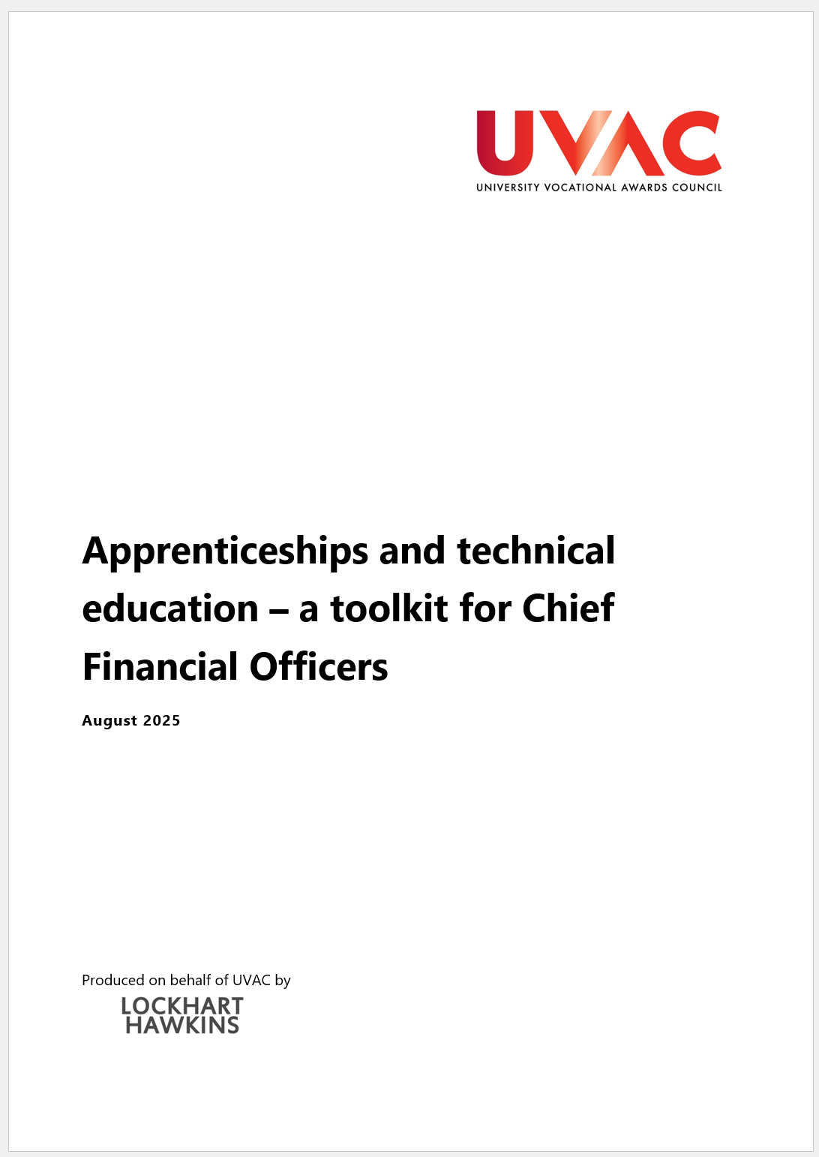
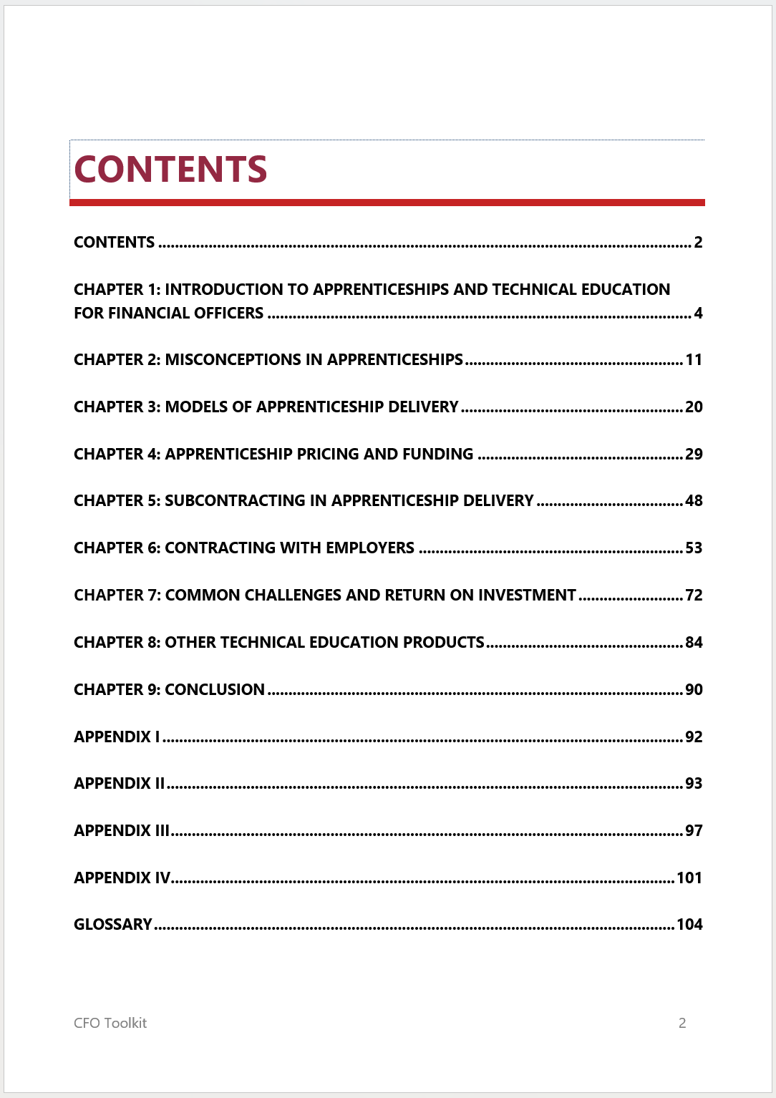
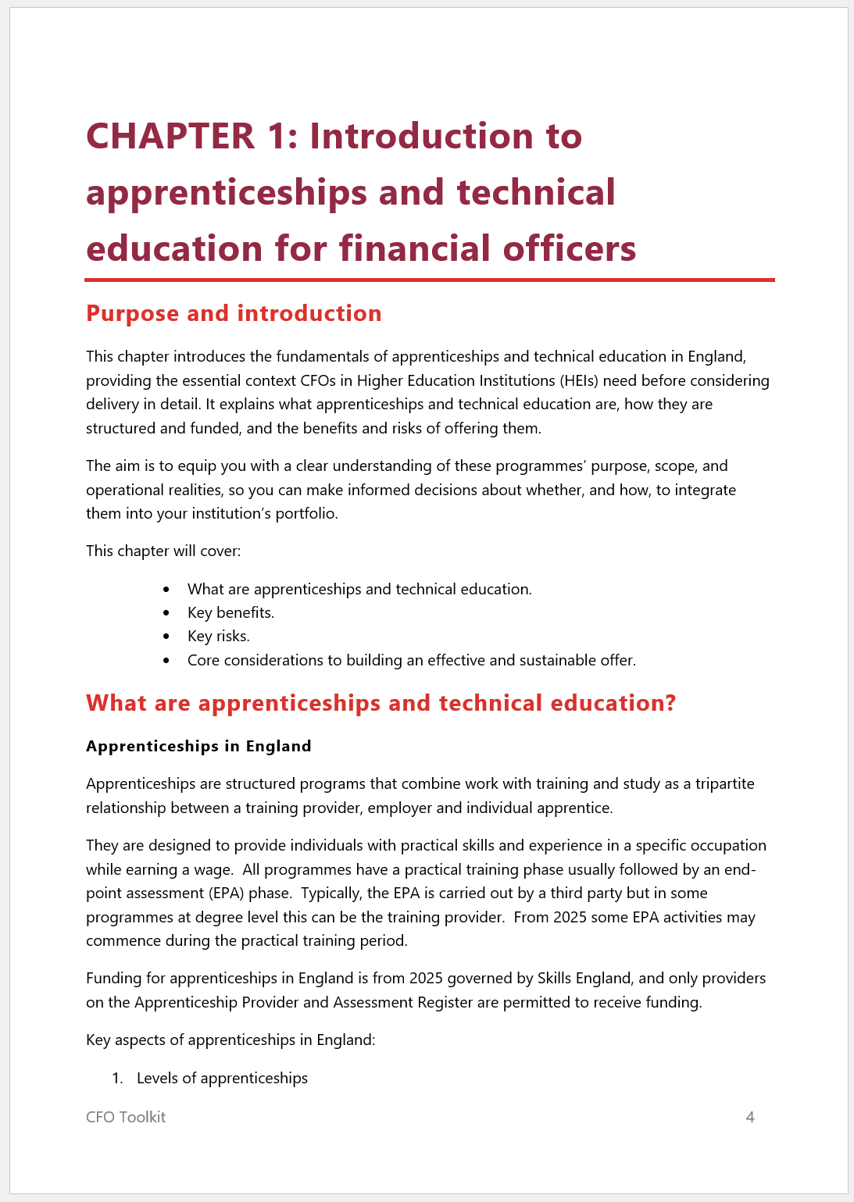
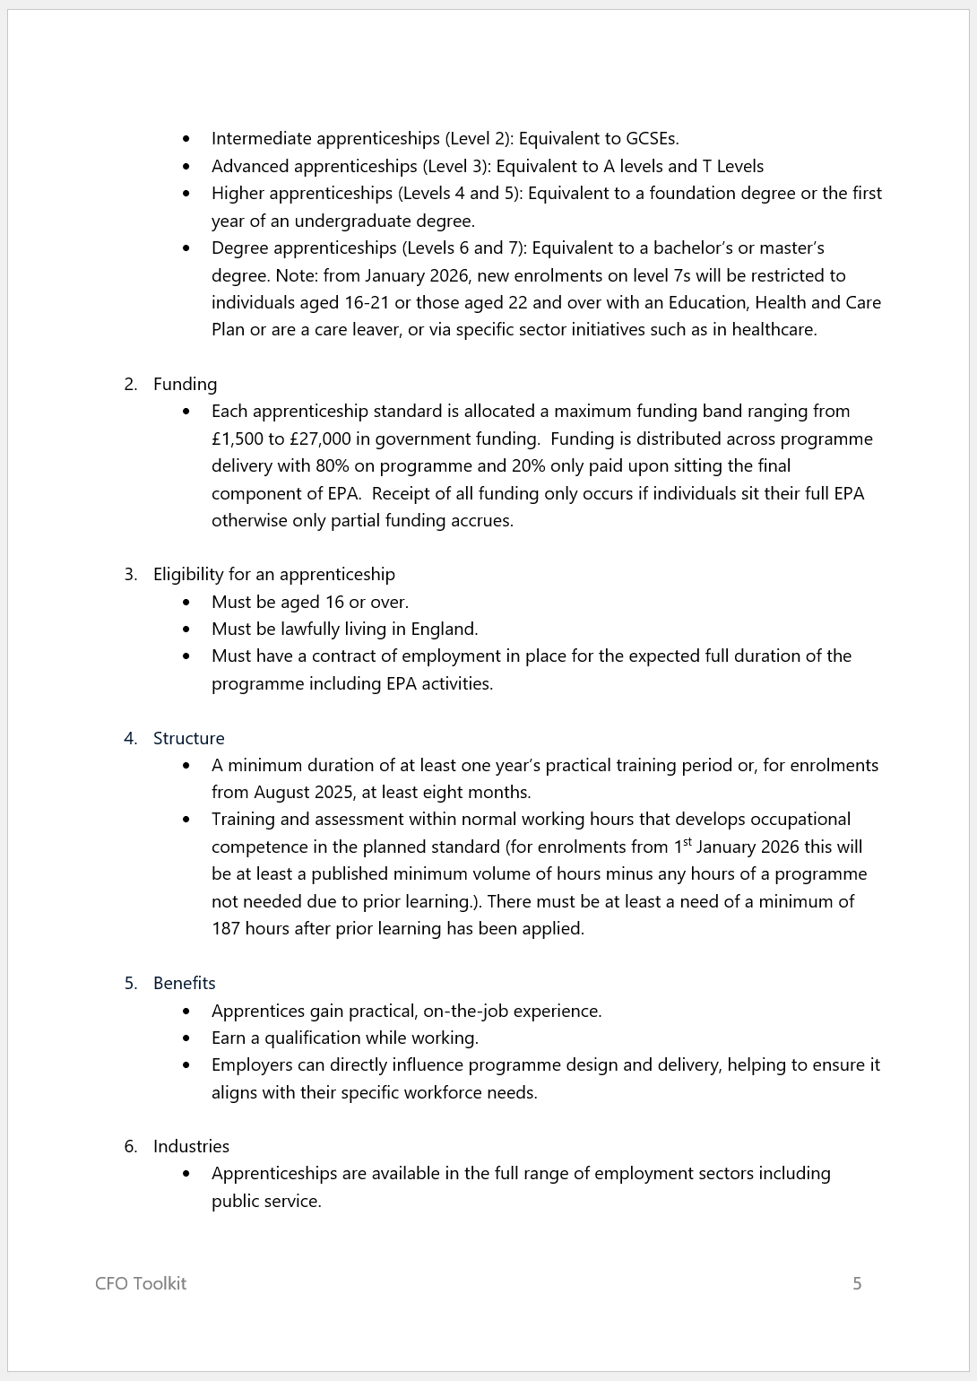
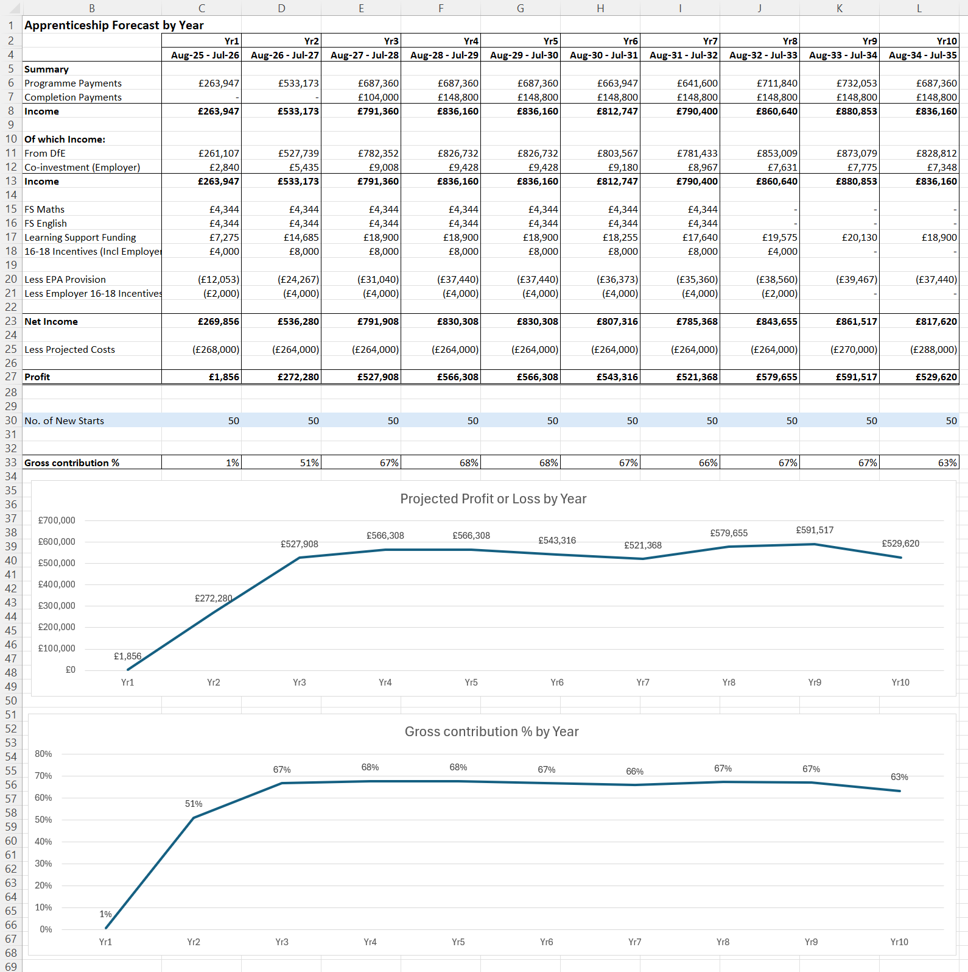
CFO Toolkit: Apprenticeships and Technical Education
Walkthrough of the CFO Toolkit: Apprenticeships and Technical Education – 29th September 2025
What does it consist of?
A detailed 110-page written guide for CFOs and Senior Leaders
Nine practical tools designed to solve common challenges and provide objective outputs
Notes:
Explain
Contributors
David Lockhart-Hawkins
Chris Cherry
Anna Sutton
Case Study Contributors
London South Bank University
Sheffield Hallam University
University of Exeter

Slide 5
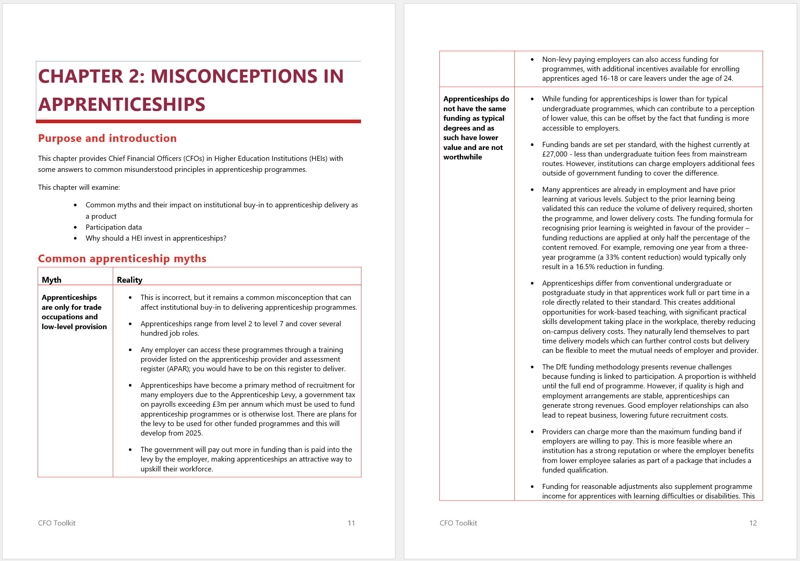
Guide for CFOs
Walkthrough of the CFO Toolkit: Apprenticeships and Technical Education – 29th September 2025
Toolkit explained
LINK
29,000 word guidebook to support tools
Chapters include:
  Addressing misconceptions
  Models of delivery
  Pricing and funding explained
  Subcontracting
  Working with employers
  Common challenges and return on investment
Case studies

Slide 6
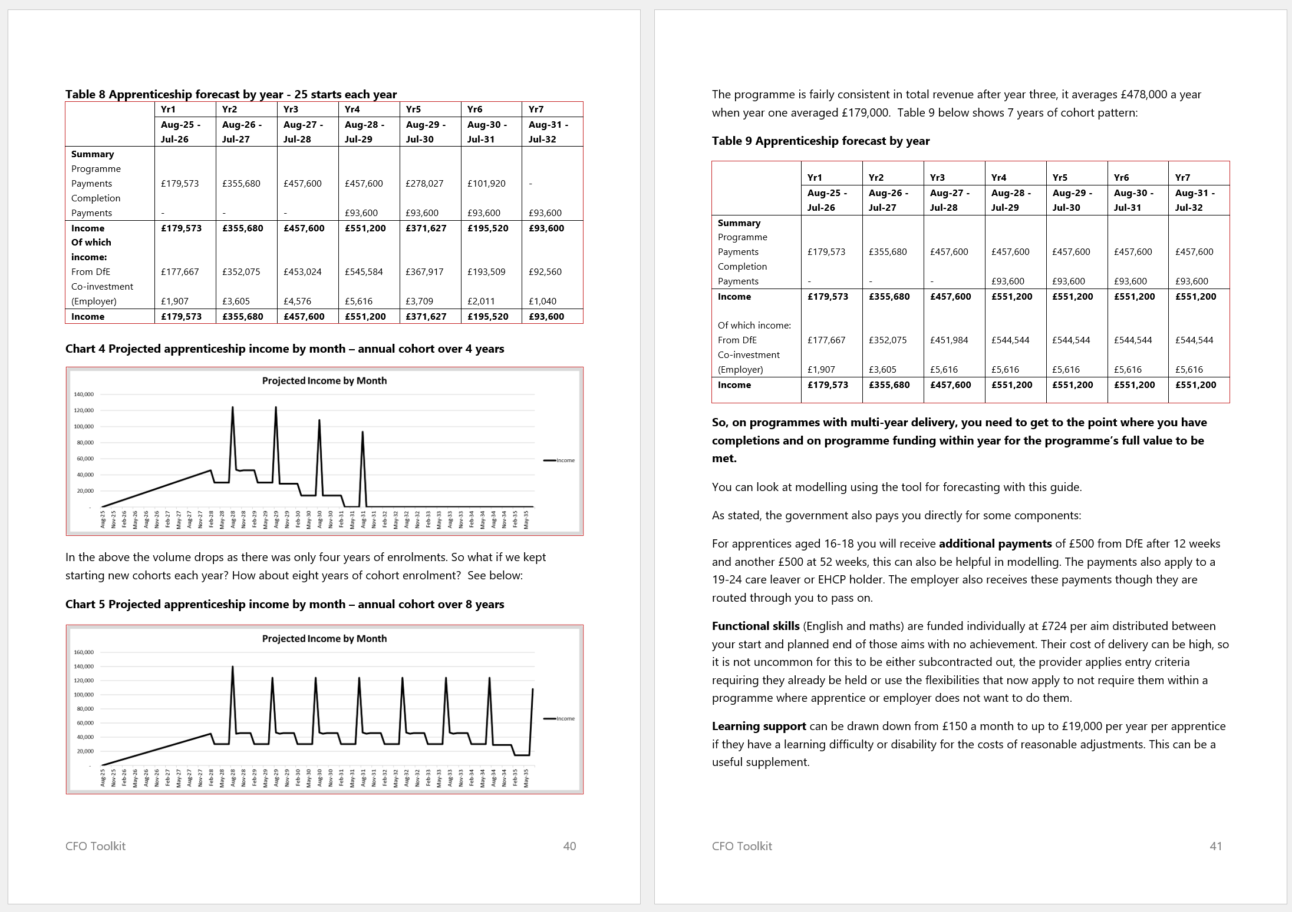
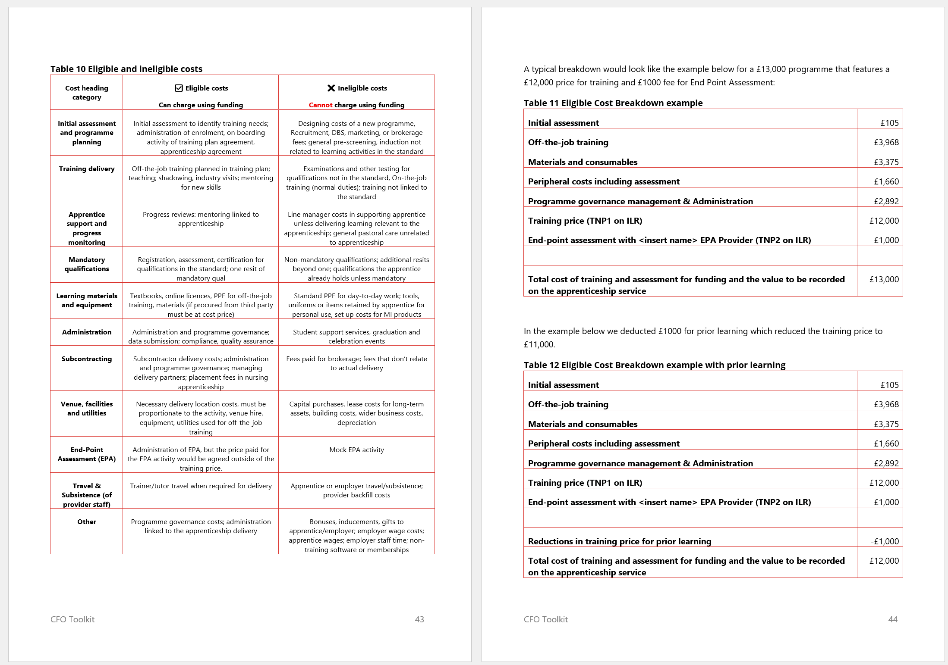
Guide for CFOs
Walkthrough of the CFO Toolkit: Apprenticeships and Technical Education – 29th September 2025
Toolkit explained
Written for CFOs from a commercial perspective
Includes explanation of key funding rule and practical concepts
Also: illustrations & best practice for improving and understanding financial performance
Tools linked to chapters
Useful for all senior leaders

Slide 7
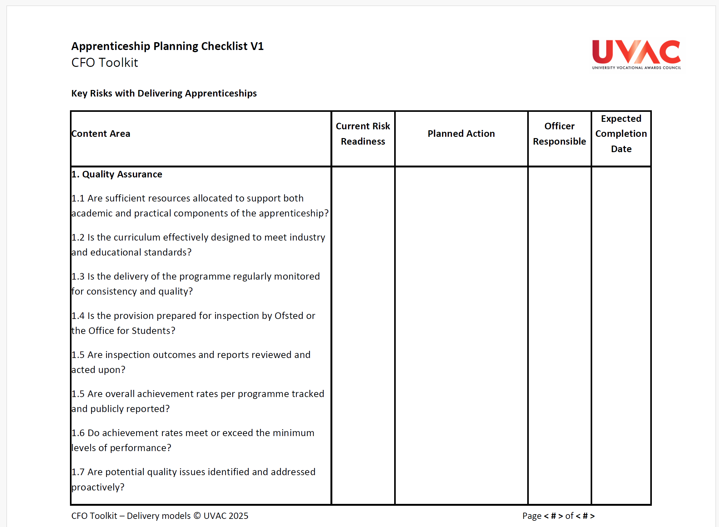
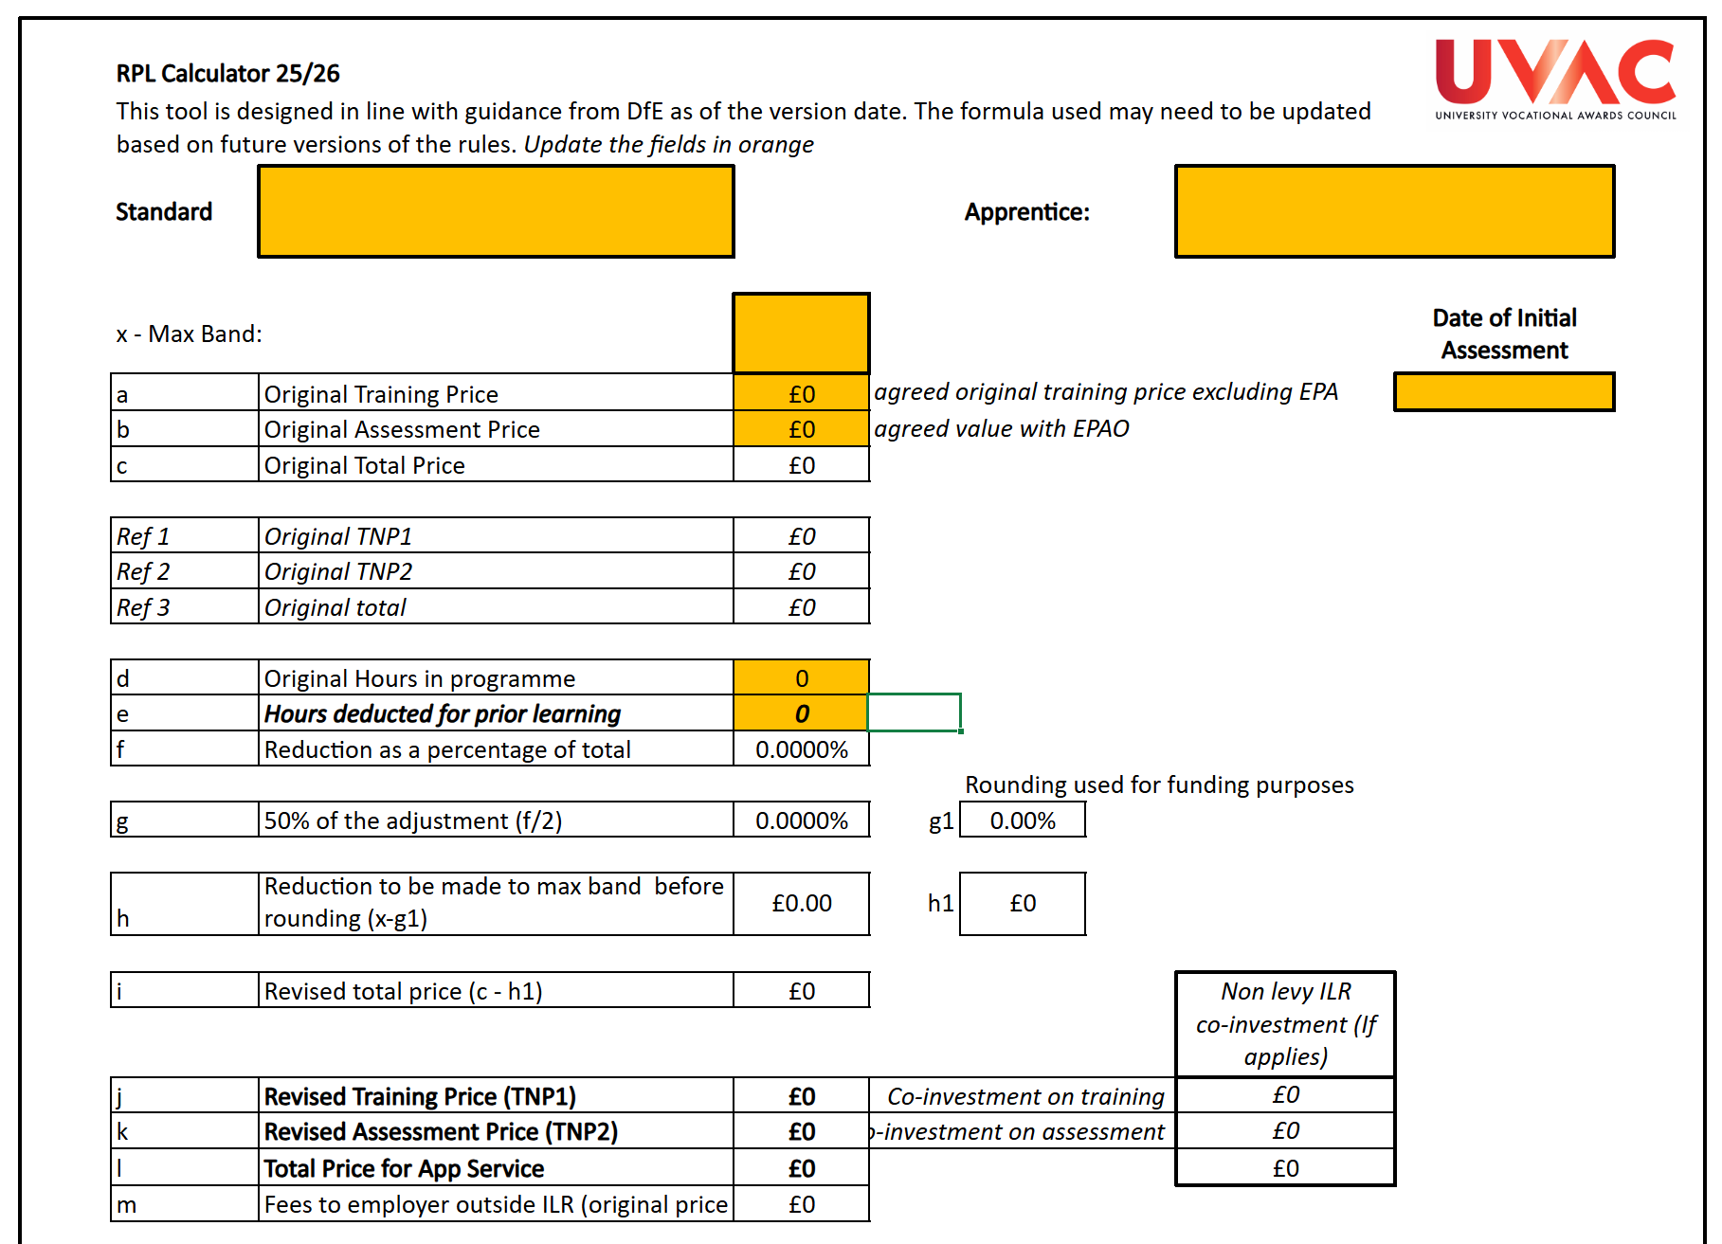
Tools
Walkthrough of the CFO Toolkit: Apprenticeships and Technical Education – 29th September 2025
Practical support for CFO and leaders
Apprenticeship Planning Checklist
Apprenticeship Delivery Models Checklist
Basic Apprenticeship Programme Costing Tool
Advanced Apprenticeship Programme Costing Tool
Apprenticeship Financial Forecasting Tool
Recognition of Prior Learning Calculator
Price Breakdown Tool
Employer Contracting Checklist
Return on Investment Calculator
Notes:
‘Apprenticeship Planning Checklist V1.0’ - This checklist supports institutions to assess and manage key risks in apprenticeship delivery, including quality, compliance, and safeguarding. It captures current readiness, planned actions, and responsible officers to ensure a clear, proactive approach – Chapter 1, 2
‘Apprenticeship Delivery Models Checklist V1.0’ - This checklist helps institutions determine the most appropriate delivery model for each apprenticeship standard. It records the chosen method, justification, and any required actions, ensuring clarity on roles, responsibilities, and timelines. – Chapter 3
‘Basic Apprenticeship Programme Costing Tool v1.0’- This excel based tool allows you to examine the product cost and budget for delivery of a programme. – Chapter 3 (Example available)
‘Advanced Apprenticeship Programme Costing Tool v1.0’- This excel based tool allows you to examine the product cost and budget for delivery of a programme but uses additional data points such as contact time in staff roles to establish staff capacity projections . – Chapter 3 (Example available)
‘Apprenticeship Financial Forecasting Tool v1.0’ – This excel based tool allows the profiling of revenue of programmes linked to retention on programme, informing when you are likely to receive monies and your revenue profile. – Chapter 3, 4 (Example available)
‘RPL Calculator v1.0’ – This excel based tool allows you to enter the details of your apprenticeship programme in price and planned hours and the hours identified for prior learning. This then calculates the adjustment you would need to make to training price. – Chapter 4, 7 (Example available)
‘Price breakdown Tool v1.0’ – This excel based tool allows you to enter the details of a programme and standardise your approach to calculating eligible costs on a programme by programme basis with an output of a breakdown for an employer that could be absorbed into a contract for services schedule. – Chapter 4 (Example available)
‘Employer contracting checklist v1’ – This word document is a checklist of all core areas that should be considered when agreeing to work with employers. – Chapter 6
‘ROI Tool v1’ – This excel based tool allows you to calculate return on investment including optional, editable variables that are factors within apprenticeship delivery. – Chapter 7 (Example available)
Several tools have example version with demonstration data within them. They are populated to give a guide as to how they could be completed.

Slide 8
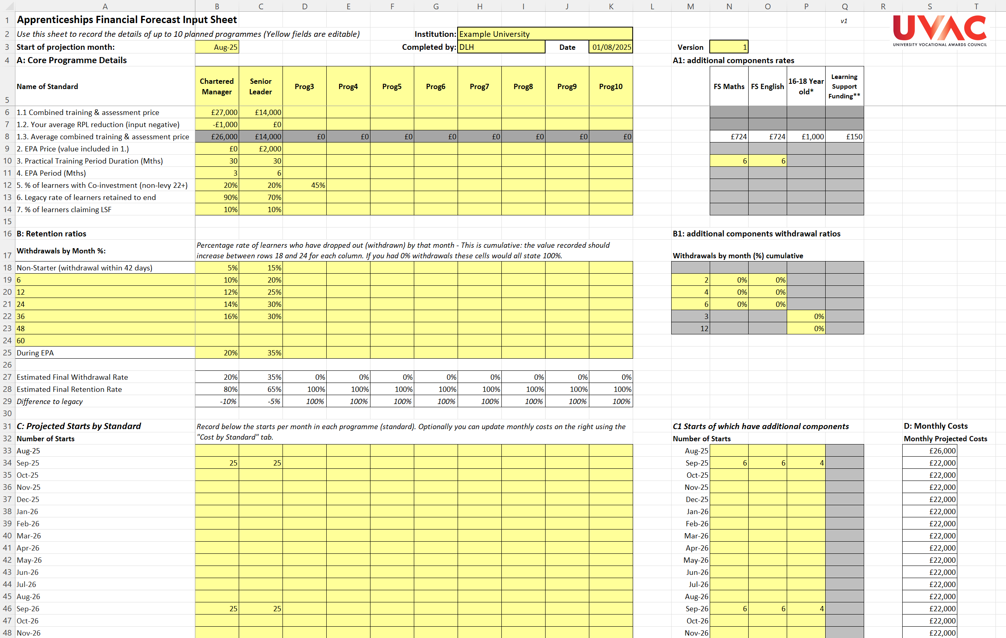
Apprenticeship Financial Forecasting
Walkthrough of the CFO Toolkit: Apprenticeships and Technical Education – 29th September 2025
Practical support for CFO and leaders
10 year, 10 programme model
Editable variables including:
  Start year
  Pricing
  Durations
  Withdrawal points
  Co-investment %,
  LSF %,
  Functional skills
Notes:
Show Forecasting tool example

Slide 9
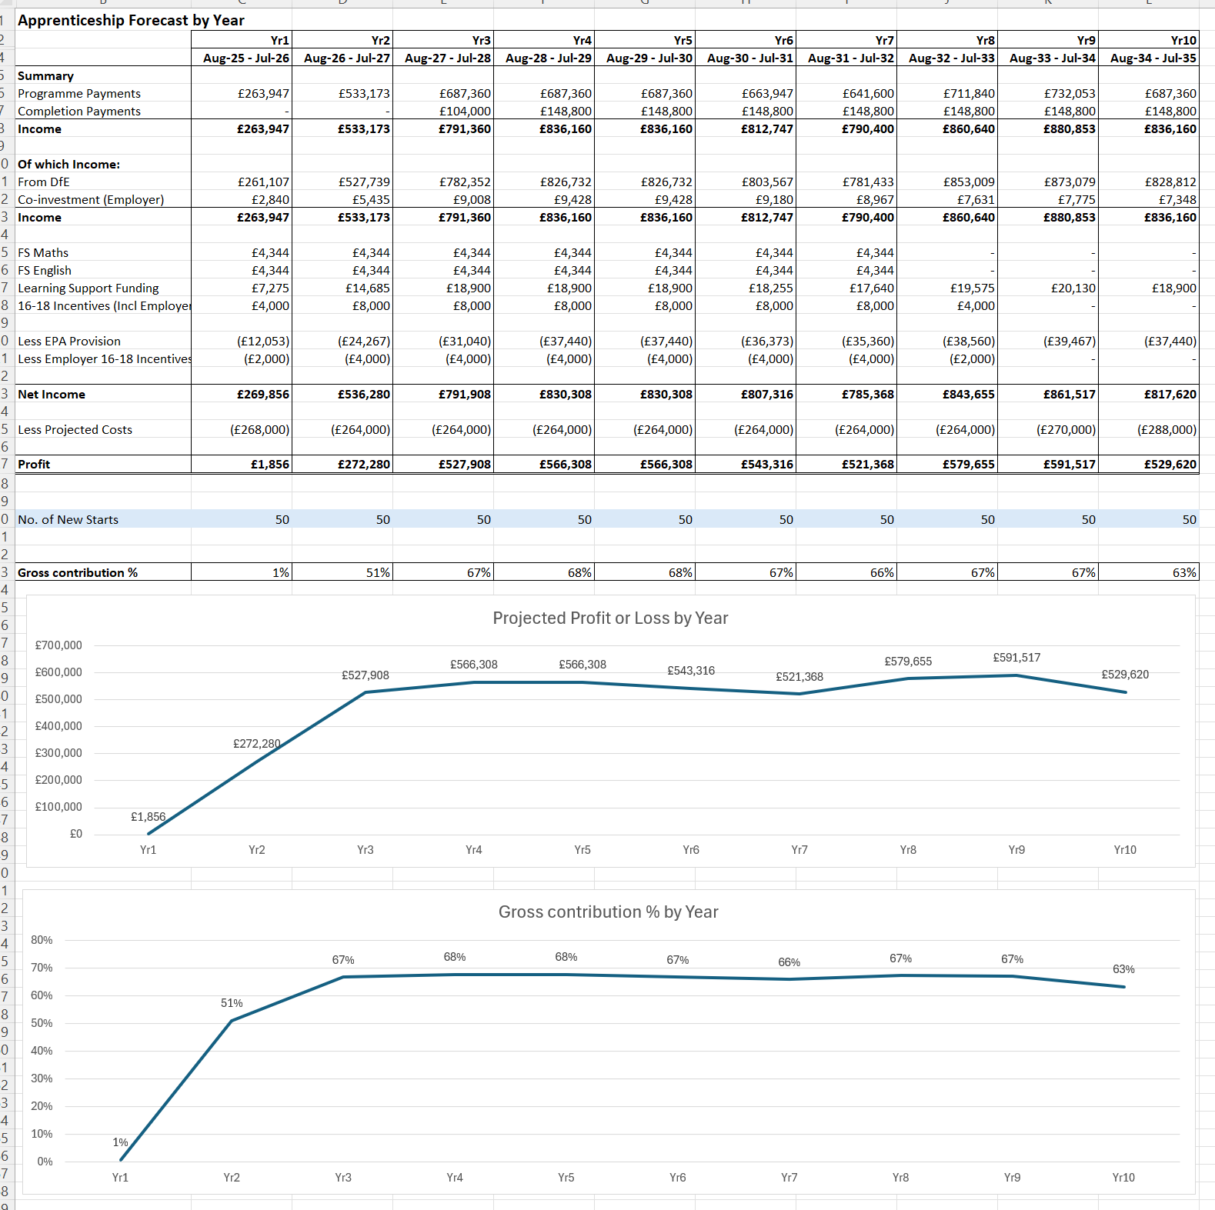
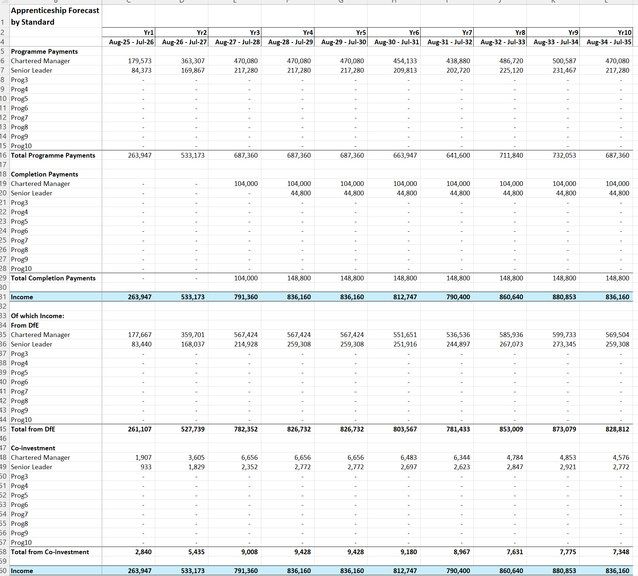
Apprenticeship Financial Forecasting
Launching the CFO Toolkit: Apprenticeships and Technical Education – 29th August 2025
Practical support for CFO and leaders
Forecasts by month, year, standard
Costs can be added
Notes:
Show Forecasting tool example

Slide 10
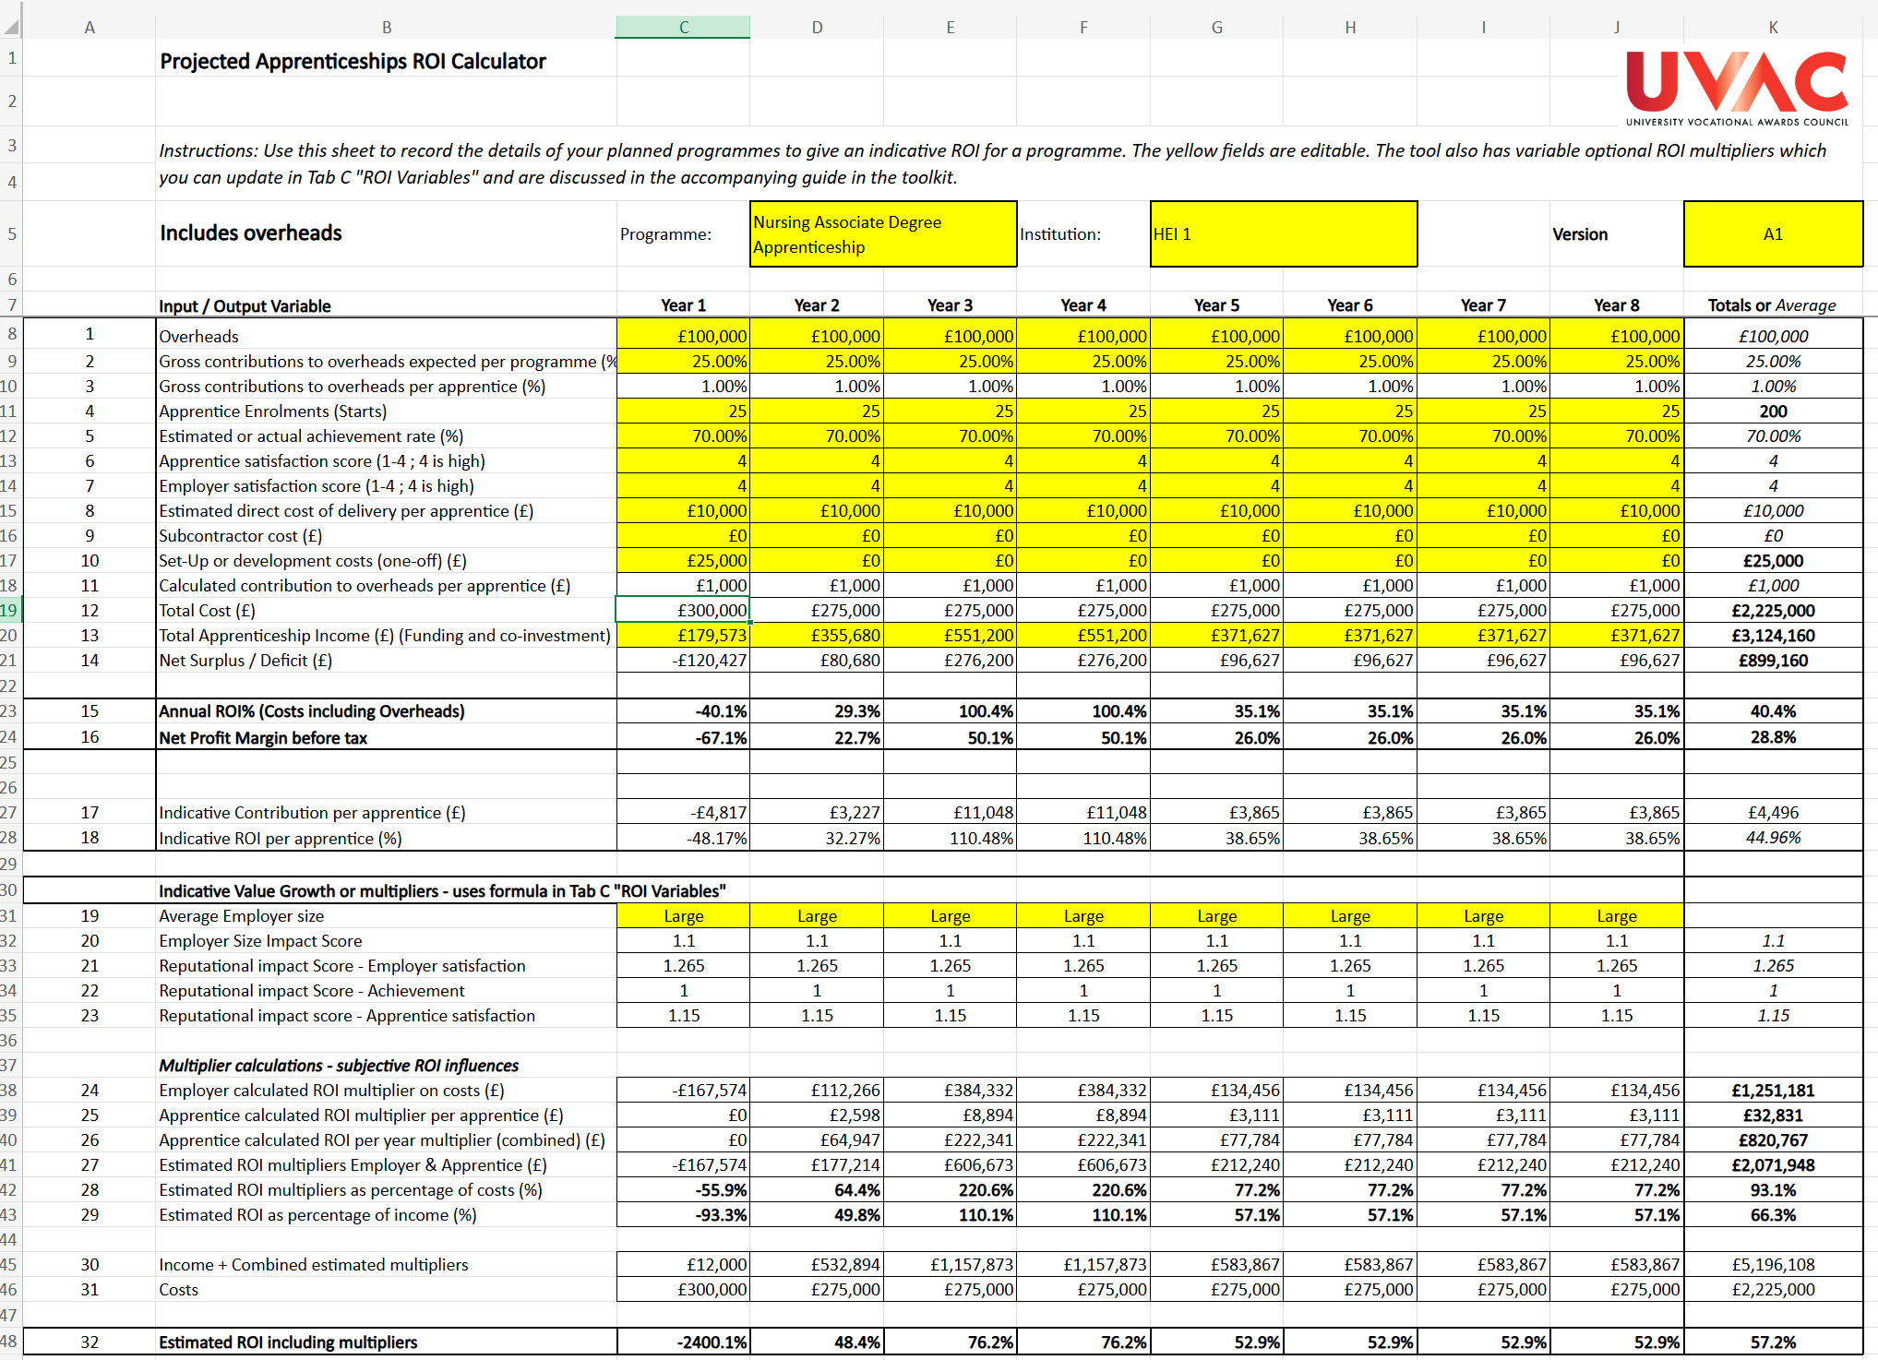
Apprenticeship ROI
Walkthrough of the CFO Toolkit: Apprenticeships and Technical Education – 29th September 2025
Practical support for CFO and leaders
Editable variables for customisation
Example multipliers
Editable contribution expectations
Notes:
Show Forecasting tool example

Slide 11
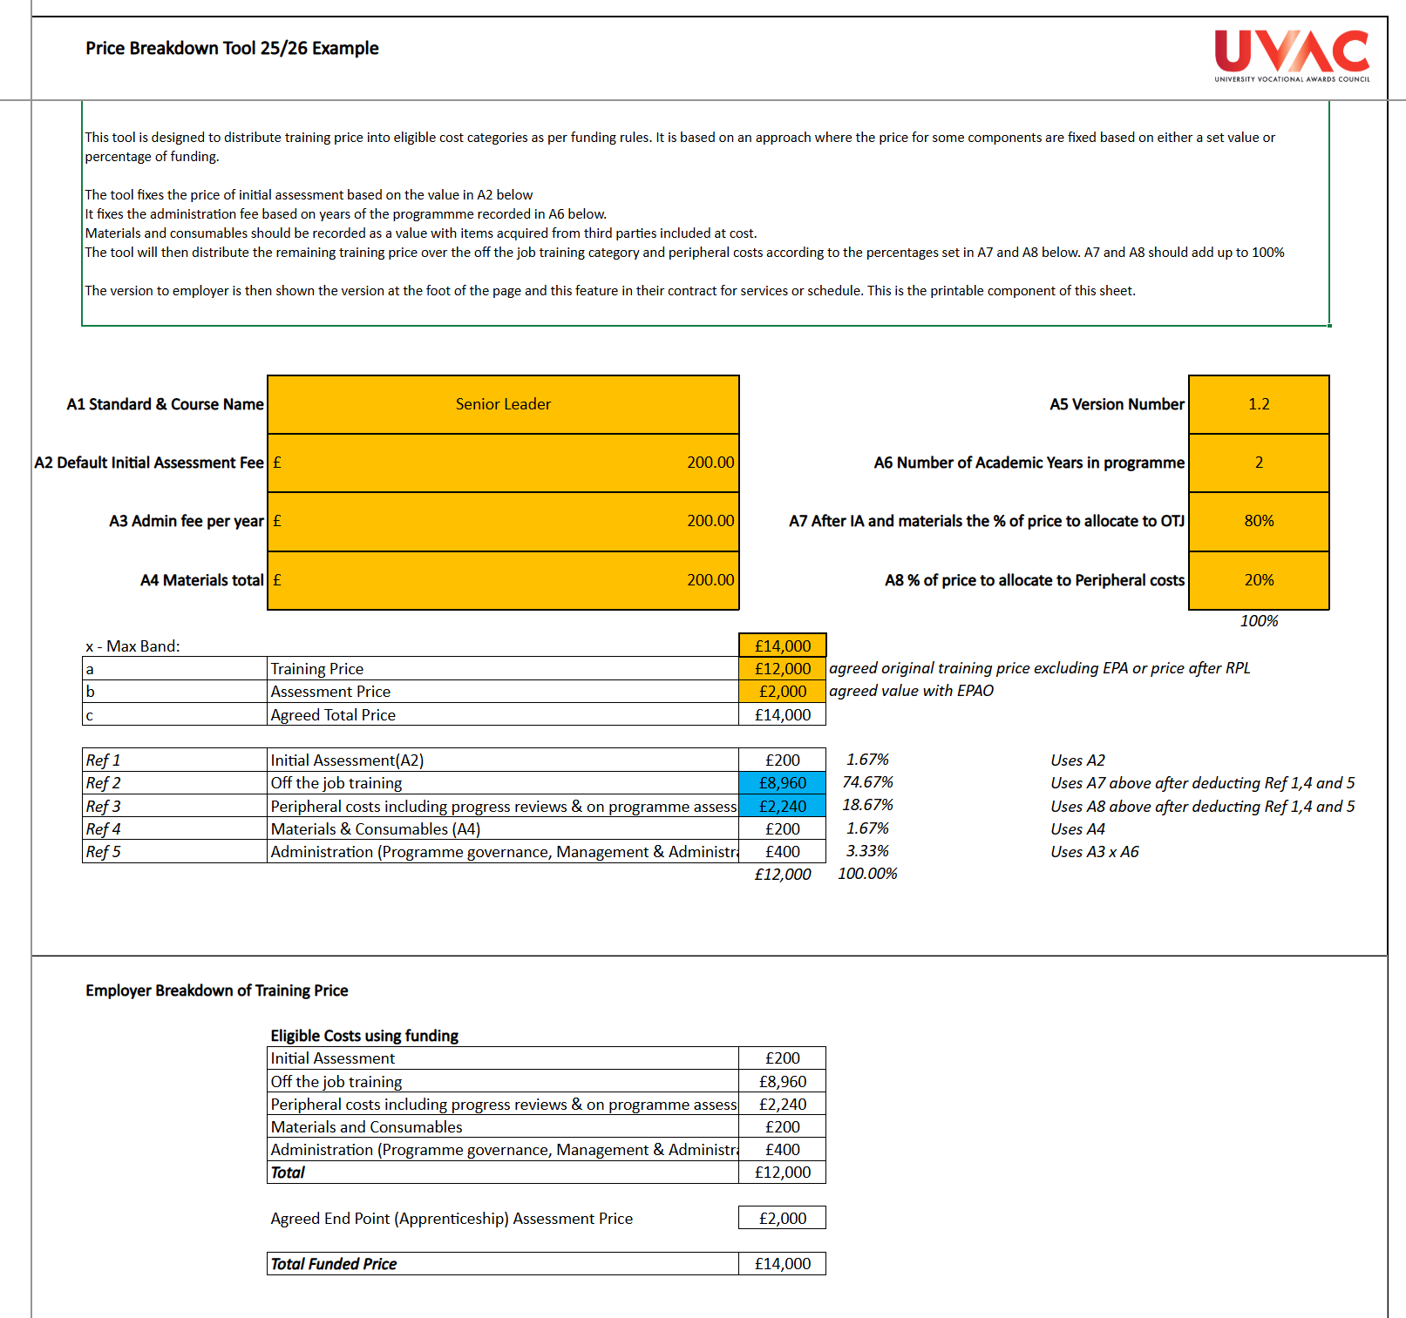
Apprenticeship Breakdown of Price
Walkthrough of the CFO Toolkit: Apprenticeships and Technical Education – 29th September 2025
Practical support for CFO and leaders
Supports with compliant pricing within contracts for services with employers
Notes:
Show Forecasting tool example

Slide 12
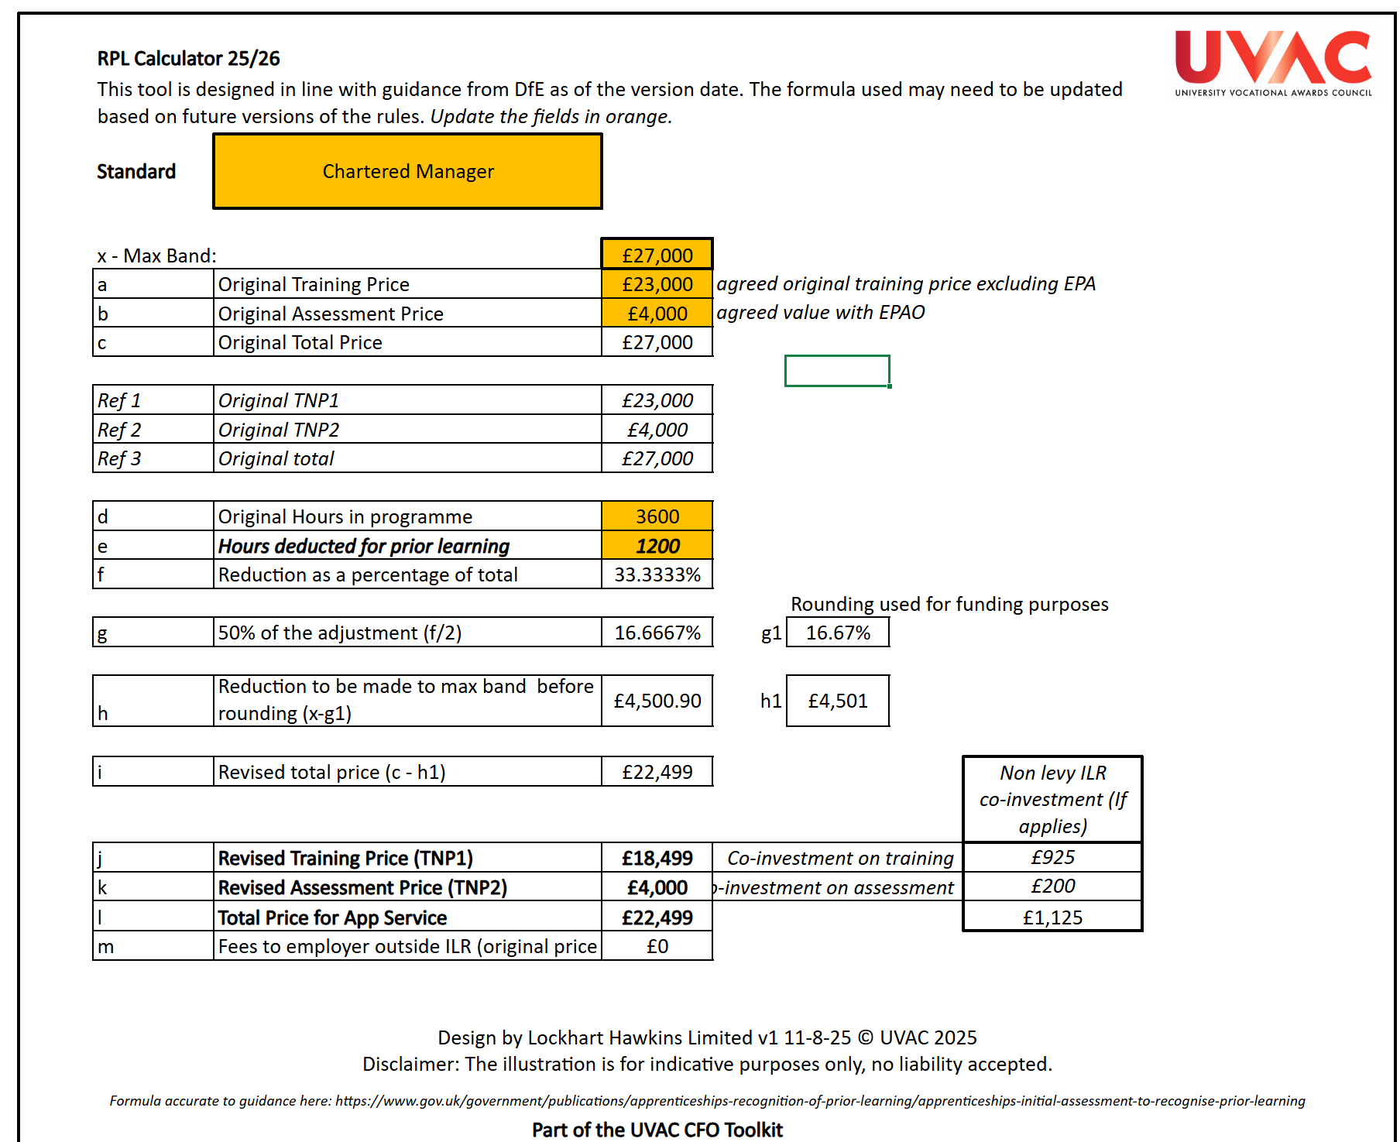
Apprenticeship RPL
Walkthrough of the CFO Toolkit: Apprenticeships and Technical Education – 29th September 2025
Practical support for CFO and leaders
Practical tool for operational use
Uses 25/26 funding rule calculations
Supports identification of correct pricing amendments
Notes:
Show Forecasting tool example

Slide 13
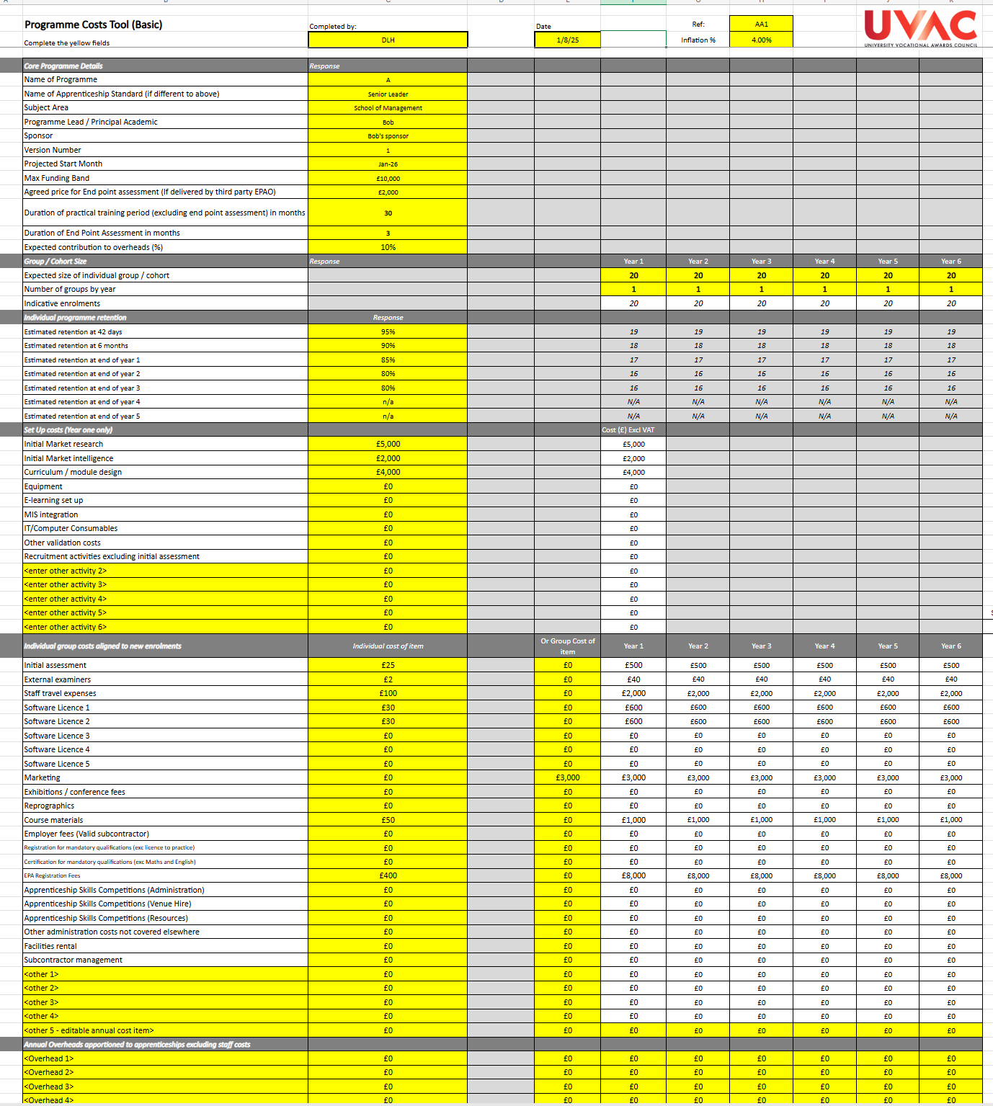
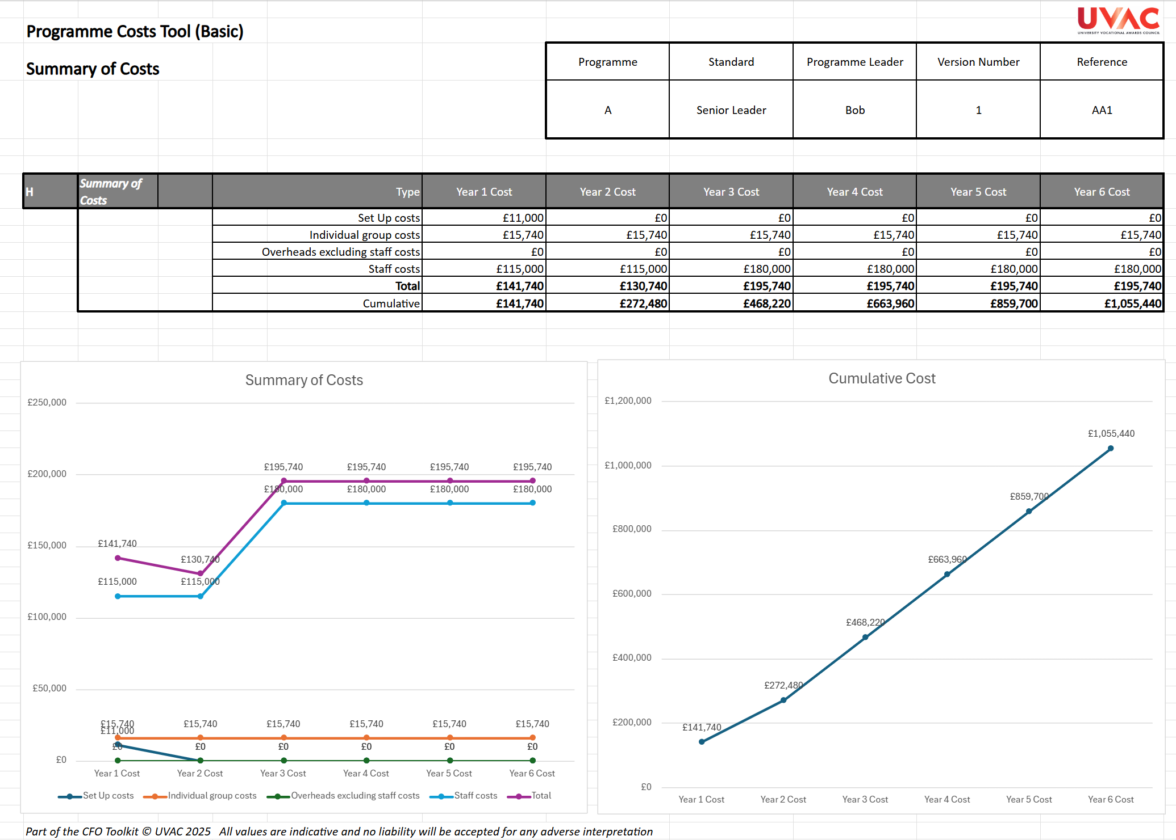
Apprenticeship Costing / Budgeting
Walkthrough of the CFO Toolkit: Apprenticeships and Technical Education – 29th September 2025
Practical support for CFO and leaders
Two models: Basic & Advanced
Used to establish cost of delivery, with editable variables including contribution
Notes:
Show Forecasting tool example

Slide 14
Questions

Slide 15
Thank you
Walkthrough of the CFO Toolkit: Apprenticeships and Technical Education – 29th September 2025
– 29th August 2025

