Slide 1
Rethinking Level 7 Accountancy
Jonathan Mills
AFMDA Programme Director
Skills England level 6 AFMDA Trailblazer Group Chair
j.mills5@aston.ac.uk

Slide 2
Webinar Objectives
The AFMDA and L3-7 accountancy apprenticeship landscape
BRIDGE - Gradual progression from foundation apprenticeship to level 7 with certification at every stage of the journey
DIGITAL SKILLS - Triple Badging in modules: University Degree, Professional Body exemptions/exams, plus digital skills certification from Sage and/or Microsoft (sold as short courses too?)
Potential for accreditation from several Professional Bodies: 9 ACCA and 12 ICAEW (CIOT/CIPFA) and same principle for ICAS, CIMA, IFA
Careful Mapping and Scaffolding to minimise what is left at the end of the AFMDA, to make affordable achievable level 7 (eligible for 2-year Masters Loan)
Anything you want to know? – please speak now – use chat - Q&A to finish

Slide 3
Accounting Apprenticeships
 | FOUNDATION APPRENTICESHIP (Level 3) | ACCOUNTING TECHNICIAN (Level 4) | DEGREE APPRENTICESHIP (Level 6) | PROFESSIONAL ACCOUNTANT (Level 7)
Reference | TBA | ST0003 | ST1303 | ST0001
Funding | Up to £4.5k | £12k | £27k | £21k
Typical duration | 8 months | 18 months | 36 months | 36 months
Age restrictions (from January 2026) | None | None | None | 21 years old at start
EQA provider | In progress | Ofqual | OfS | Ofqual
Email j.mills5@aston.ac.uk to join in apprenticeship development in DfE/Skills England Trailblazer Group

Slide 4
Skills funding “Pyramid”
Using several standards is likely to improve
qualification achievement rates (QARs),
provide multiple exit points,
and increase funding.
TACTICAL implementation
OPERATIONAL
FOUNDATION APPRENTICESHIP
LEVEL 7
up to £21k funding for under 21’s
LEVEL 5 and 6
Accounting Finance Manager Degree Apprenticeship
up to £27k funding for any age
LEVEL 4
Accounting Technician
up to £12k funding for any age
LEVEL 3 fast track access
£2k for employers
Up to £4.5k for learning providers
Unpaid 8-month internships
1x level 4 module
STRATEGIC

Slide 5
Level 4 cost comparison
Do you have AAT Colleges you work with?
AAT level 3 and 4 feed into the AFMDA
Use Foundation Apprenticeship as Fast Track HE Access Course

Slide 6
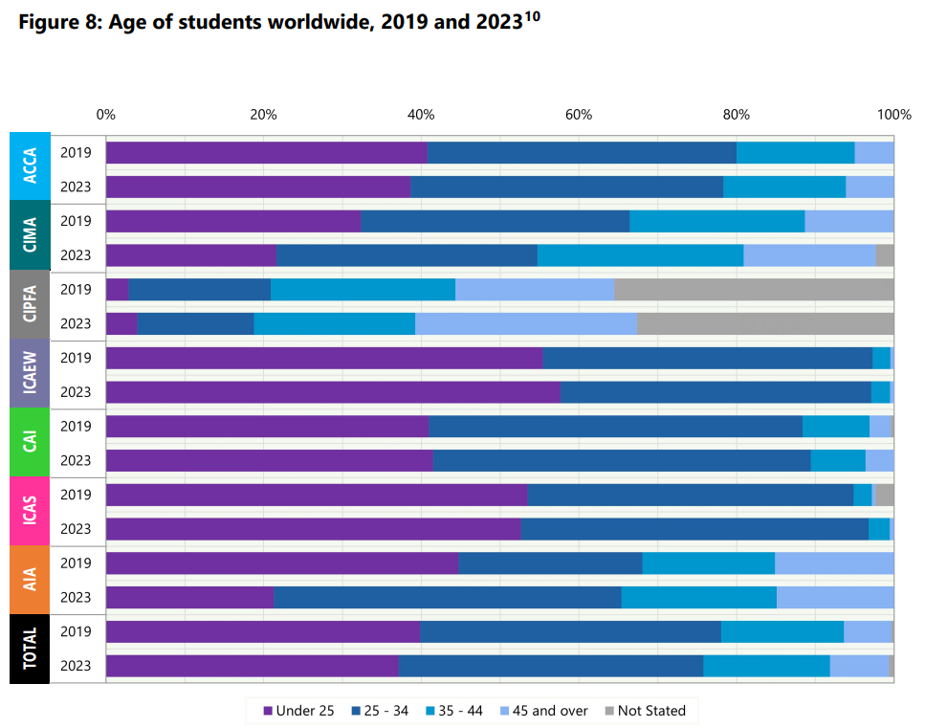
From January 2026 level 7 funding will no longer be available to those 22 years old and over.
This FRC report shows under 25s. It appears to be reasonable to estimate from this that c.70% of current students doing level 7 are over 22 years old.

Slide 7
FRC key facts and trends
Prof. Body | UK Students
ACCA | 72,370
CIMA | 40,797
TOTAL | 113,167
>21 yrs old | 70%
Est.<21 | 79,217
Prof. Body | UK Students
CIPFA | 1,937
ICAEW | 28,348
TOTAL | 30,285
>21 yrs old | 70%
Est.<21 | 21,200
Key Facts and Trends in the Accountancy Profession

Slide 8
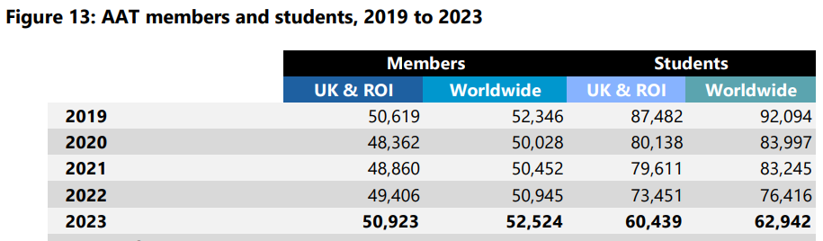
FRC key facts and trends
AAT | UK & ROI
Students | 60,439
Members | 50,923
TOTAL | 111,362
>21 yrs old | 70%
Est.<21 | 77,953
The AAT members and students that are over 22 years old will no longer be funded to do level 7, so maximise use of AFMDA to get chartered/qualified
Key Facts and Trends in the Accountancy Profession

Slide 9
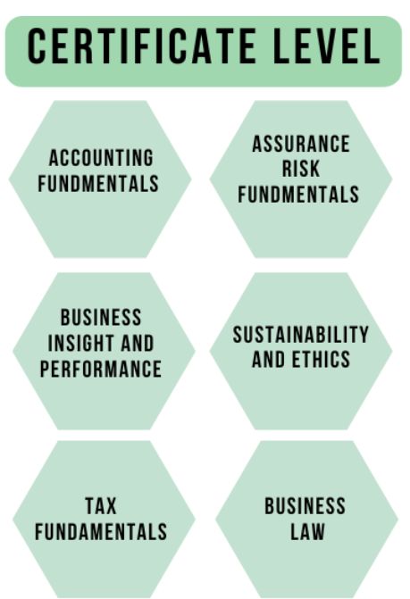
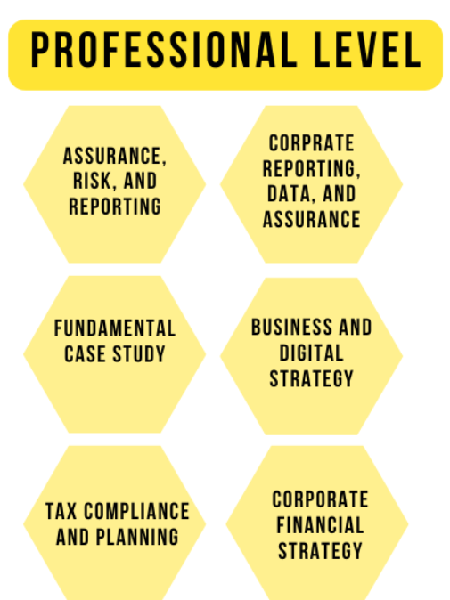
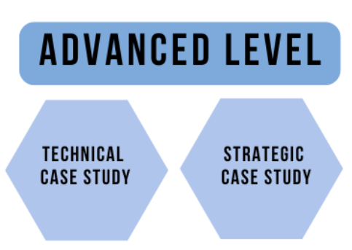
ICAEW’s new syllabus (Sep25 launch)
LEVEL 4
LEVEL 6
LEVEL 7

Slide 10
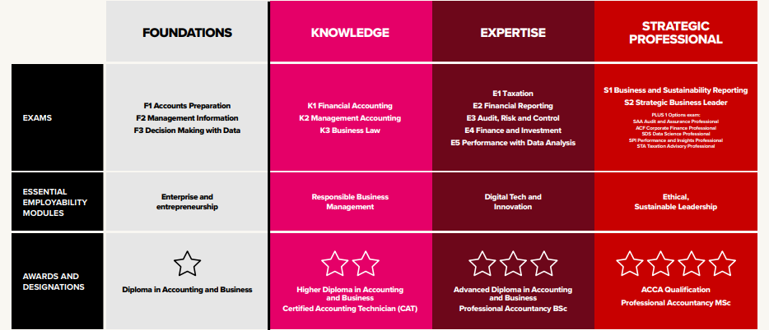
ACCA’s new syllabus (Sep26 launch - ACCA Qualification Levels infographic.pdf)
LEVEL 4
LEVEL 6
LEVEL 7

Slide 11
Proposed Level 7 (Funding is unavailable if over 22)

Slide 12
QUESTION | ANSWER
Who would join T&F group for Foundation Apprenticeship?
Do you think UVAC should form a Knowledge Cluster for Accountancy?

