Slide 1
State of the Nation
Policy and UVAC Updates
Friday, 23 May 2025

Slide 2
Welcome
Brief Reminders
Policy Reflections
Old Government/new Government
Higher and degree apprenticeships
Why is HE seen as the problem?
Perception and language
New Government
Challenges
Apprenticeships
Wider skills
Level 7
Team Updates
Black Box resources including contracts
Summer webinar programme
Knowledge Networks
Last words
Conference 2025
Membership renewal
Skills England
Publications

Slide 3
1. About
Advocacy
Active advocates for apprenticeships, work-based and professional development programmes.
Membership Services
Support on quality enhancements; policy, practice and pedagogy; new technologies; compliance and regulation.
80 University Members
Data and Research
Comprehensive data; research reports; concept papers; Higher Education and Work- based Learning journal.
Knowledge Networks
Sharing successful practices through knowledge networks.
ATC Conference March 2025

Slide 4
1. Role in Apprenticeships
UVAC's Role in Shaping Apprenticeships in England
Advocacy
Before 2015
2015
2015-2020
2020-today
Membership Services
Support on quality enhancements; policy, practice and pedagogy; new technologies; compliance and regulation.
Policy Influence
System Development
Data and Research
Comprehensive data; research reports; concept papers; Higher Education and Work- based Learning journal.
UVAC advocates for HE in apprenticeship policy and delivery before degree apprenticeships launched
Degree Apprenticeships Championed
UVAC supports QAA, advises on quality assurance, and quality in programme design and delivery
Mainstream Adoption
Degree apprenticeship delivery become prominent in UK universities
Knowledge Networks
England launches degree apprenticeships, UVAC receives HEFCE funding to support growth in HE delivery and engagement
Sharing successful practices through knowledge networks.
ATC Conference March 2025

Slide 5
1. Role in Apprenticeships: Data
Earning Likelihood in 2023/24
£595 Million
OR Half a Billion Pounds+
2023/24 UVAC Members
All Starts
29,100
(24%)
Change 2020-2023
+14%
Ofsted
15% Grade 1
85% Grade 2
Age
Under 19: 6%
19-24: 25%
Over 25: 69%
Degree Starts
26,500 (73%)
Change 2020-2023
+32%
Age
<19: 12.5%
19-24: 30.5%
> 25: 57%
L7 Age
< 19: 2%
19-24: 33%
> 25: 65%
Source: HERA

Slide 6
1. Top 10 Standards (Degree): UVAC Member Share
Registered Nurse: 78%
Chartered Manager: 68%
DTSP: 49%
Police Constable: 88%
ACP: 88.5%
Chartered Surveyor: 88%
Social Worker: 85%
Paramedic: 94%
Project Manager: 40%
DTSS: 29.5%

Slide 7
1. What have we stepped out of and into?
State of the Nation
Conservative Party
Labour Party
100,000 more apprenticeships
Support for degree apprenticeships
Advanced British Standard (ABS)
Lifelong Learning Entitlement
Facilitation of training and skills at all ages/stages
Advanced manufacturing plans £4.5bn commitment including in life sciences, clear energy
‘Wasted’, ‘broken’ levy
Skills England
‘Flexible’ Growth and Skills Levy
Young people
Mayoral powers; shift from Westminster
Modern industrial strategy
FE = specialist ‘technical excellence colleges’ / ‘tertiary’ system
HE has a role in skills
Degree apprenticeships don’t register!

Slide 8
2. Context: Old Government
Advocacy
The idea of an apprenticeship as being a route to professional status goes against the grain of universities being the ‘gateway to the professions’ (NAS, 2011).
...to stimulate and create well regarded, high profile and sustainable higher apprenticeship programmes based on clear and evidenced employer demand that involve education and business partnerships in an innovative and exciting way (Crawford-Lee, 2012).
Higher and Degree Apprenticeships totally meet the objective that higher education focuses on ‘getting on rather than just getting in’ (Donelan, 2021)
Higher and degree apprenticeships support social mobility by enabling people who previously missed out on higher education to access it. Progression to university in and through work, on an apprenticeship, where previously it had not been seen as an option for the apprentice, is a strong reflection of impact, whatever the policy context (Anderson et al, 2022)
The value of degree and higher-level apprenticeships has gained considerable traction in alignment over the past decade evidenced by their bringing together the worlds of work and higher education together under dual policy objectives – productivity and social mobility (Crawford-Lee, 2025)
Membership Services
Support on quality enhancements; policy, practice and pedagogy; new technologies; compliance and regulation.
Data and Research
Comprehensive data; research reports; concept papers; Higher Education and Work- based Learning journal.
Knowledge Networks
Sharing successful practices through knowledge networks.
ATC Conference March 2025

Slide 9
2. Higher and Degree Apprenticeships
Employers pushed Apprenticeship upwards:
the ‘big’ levy paying public sector – Degree Apprenticeships developed for Registered Nursing (NHS) Social Worker (Local Authorities), Police Constables (Police Forces), Teachers
STEM areas; Degree Apprenticeships – e.g., manufacturing engineer, digital technology solutions and construction professions
Chartered Manager Degree Apprenticeship
A way to widen participation and enhance social mobility and to help tackle the low participation of women in STEM occupations
Substantial interest from individuals ‘no fee, no debt, a salary from day one and the prospect of a graduate job on completion’
An opportunity for new partnerships with PSRBs, LEPs, FECs and ITPs
A new income stream for HE providers at levels 4 – 7
Less Apprenticeship provision at level 2 and with non-levy payers?
Advocacy
Membership Services
Support on quality enhancements; policy, practice and pedagogy; new technologies; compliance and regulation.
Data and Research
Comprehensive data; research reports; concept papers; Higher Education and Work- based Learning journal.
Knowledge Networks
Sharing successful practices through knowledge networks.
ATC Conference March 2025

Slide 10
2. HE – The Problem?
The Learning and Work Institute called for measures to ‘dampen the growth of higher and degree apprenticeships for older workers’ and proposed that:
Employers provide 50% of the cost of apprenticeships at level 4 and 5, and 75% of the cost of apprenticeship at level 6 and 7 for those aged 25 and over. This funding to be provided by employers from outside their Levy payments. (2020)
Association of Colleges (AoC) in its recommendations on the 2020-1 spending round suggested:
It would seem more appropriate for apprenticeships at level 6 and above to be funded from the higher education teaching budget. (AELP for some time held/holds a similar policy position).
The Lords Youth Unemployment Committee’s report, Skills for Every Young Person called for ‘apprenticeships at levels 6 and 7 to be removed from the scope of levy funding’ and proposed that:
The Government must require that any employer receiving funding from the apprenticeship levy must spend at least two thirds of that funding on people who begin apprenticeships between levels 2 and 3 before the age of 25. The other third could be spent on older workers and those studying at levels 4 and 5. (2021)
Advocacy
Membership Services
Support on quality enhancements; policy, practice and pedagogy; new technologies; compliance and regulation.
Data and Research
Comprehensive data; research reports; concept papers; Higher Education and Work- based Learning journal.
Knowledge Networks
Sharing successful practices through knowledge networks.
ATC Conference March 2025

Slide 11
2. Perception and Language
The debate has all too often pitched as university OR technical / vocational / apprenticeship options
“We remain far too obsessed by the A level and university route. … relative to other European countries, we have more young people following these routes and far fewer studying for higher-level technical and vocational qualifications” (Paul Johnson – Director of the Institute for Fiscal Studies, and alumni Keble College, Oxford, – The Times, 28 October 2019)
Apprenticeships “can support employability and enable individuals to gain skills in a non-academic context” – The Social Mobility Commission
Underplaying the importance of the skills agenda to HE
Failing to reflect the diversity of students and provision provided
Too much focus on a deficit model
Advocacy
Membership Services
Support on quality enhancements; policy, practice and pedagogy; new technologies; compliance and regulation.
Data and Research
Comprehensive data; research reports; concept papers; Higher Education and Work- based Learning journal.
Knowledge Networks
Sharing successful practices through knowledge networks.
ATC Conference March 2025

Slide 12
2. Challenges: New Government
Low productivity, economic inactivity and low economic growth, the weak state of the public finances and the transition to a net zero economy will be key challenges faced by any incoming government.
Appropriate apprenticeship and skills policies will be required to deal with each of these challenges, with government needing to lead activities to tackle labour supply issues and skills shortages and gaps, in order to raise productivity and economic growth (Crawford-Lee, 2024).
Arguably the most prominent skills shortage in the UK is the registered nurse, a bachelor’s degree occupation.
There are 47,000 nursing vacancies, representing a record high nursing vacancy rate of 11.8%. Nearly 27% of NHS nurses are from outside the UK. (nurses.co.uk 13 November 2023).
The most prominent skills gap in the UK concerns management skills:
Anyone concerned with skills policy needs to remember… that a poorly skilled 27-year-old employee has 40 years of poorly skilled, low productivity work ahead of them.
Skills training and apprenticeships must not be just for young people.
Advocacy
Membership Services
Support on quality enhancements; policy, practice and pedagogy; new technologies; compliance and regulation.
Data and Research
Comprehensive data; research reports; concept papers; Higher Education and Work- based Learning journal.
Knowledge Networks
Sharing successful practices through knowledge networks.
ATC Conference March 2025

Slide 13
2. Apprenticeships: New Government
Higher and degree apprenticeships are fundamental to delivering the Labour Government’s five missions.
Here’s Why
Kickstart economic growth – involves prioritising and boosting higher and degree apprenticeships for individuals of all ages, in the eight growth driving sectors defined in the Industrial Strategy.
Make Britain a clean energy superpower – equates to prioritising apprenticeships, regardless of level and age of apprentice, that enable Britain to deliver on clean energy innovation.
Take back our streets – equates to more, PCSO and police constable degree apprentices.
Break down barriers to opportunity – equates to using higher and degree apprenticeships at level 4 to level 7 to provide new pathways to skilled and registered professions and higher-level occupations for individuals of all ages.
Build an NHS fit for the future – equates to more nursing associate, registered nurse, community nurse and advanced clinical practitioner higher and degree apprenticeships, for individuals of all ages and backgrounds.
Advocacy
Membership Services
Support on quality enhancements; policy, practice and pedagogy; new technologies; compliance and regulation.
Data and Research
Comprehensive data; research reports; concept papers; Higher Education and Work- based Learning journal.
Knowledge Networks
Sharing successful practices through knowledge networks.
ATC Conference March 2025

Slide 14
2. Wider Skills Policy: New Government
Advocacy
A comprehensive ALL AGE, ALL LEVEL, ALL PROVIDER approach to apprenticeship and skills is needed if government is to tackle the UK’s economic ills and deliver high-quality public sector services.
UK’s inactivity rate has increased since before the pandemic. The Times notes that this problem is costing the economy £39bn through labour and skills shortages…any organisation that doubts the need for an ALL AGE, ALL LEVEL, ALL PROVIDER apprenticeship and skills programme should reflect on this
£39 billion figure.
Membership Services
Support on quality enhancements; policy, practice and pedagogy; new technologies; compliance and regulation.
Data and Research
Comprehensive data; research reports; concept papers; Higher Education and Work- based Learning journal.
Knowledge Networks
Sharing successful practices through knowledge networks.
ATC Conference March 2025

Slide 15
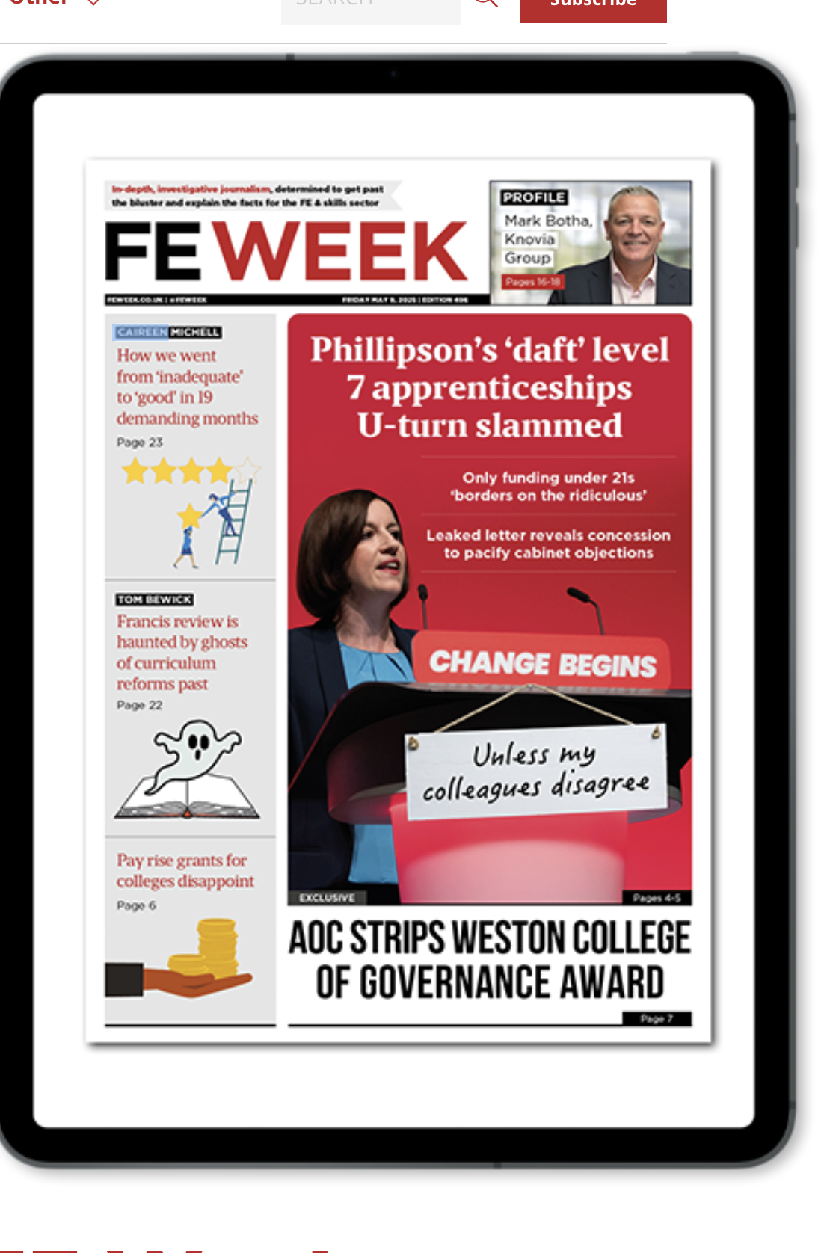
2. Level 7 impact
UVAC called the leaked proposal for age eligibility limited to 16-21-year-olds ‘retrograde and ridiculous’, ‘daft and disingenuous’.
UVAC/sector response can be found HERE, HERE, HERE and HERE.
Likely impact on Level 6: Kate Ridley-Pepper has written to UVAC stating:
“We also remain keen to work with you on L6 and other potential new offers that HEIs might be best placed to deliver.”

Slide 16
2. Top 10 Standards (Level 7): UVAC Member Share
Accountancy: 0%
Senior Leader: 42%
ACP: 88.5%
Solicitor: 5%
DTSS: 29.5%
Senior People: 29%
AI Data Specialist: 10.5%
Academic: 81%
Town Planner: 86%
Architect: 100%

Slide 17
3. UVAC Member Services Update Summer / Autumn 2025

Slide 18
UVAC Member Services
Latest Policy & Good Practice
Black Box Resources& Webcasts
UVAC Knowledge Networks
2025/2026 Mandatory Document Templates
Webinar Programme
State of the Nation & Podcast

Slide 19
Webinar Series
https://uvac.ac.uk/events/
Current hot topics latest guidance
Working with the DAKN to share latest good practice and resources
Government and stakeholder updates to explain latest policy and implementation plans
Member experiences and advice

Slide 20
 | MEMBERS EVENT PROGRAMME BY DATE
 | Topic | Content | Registration Link
1. | Funding Rules - 2025/2026 Impact and Implications | This session is for everyone involved in apprenticeship delivery from onboarding to EPA and those involved in implementing the ESFA Funding Rules in any aspect of their role. This session will set out the changes in the DfE 2025/ 2026 Apprenticeship Funding Rules and explore the implications of these changes on day-to-day practice, policy and procedures. | Wed 21 May 2.00 – 4.00
2. | A Guide to Audit and Risk Governance and Oversight | This deep dive session will set out a framework for apprenticeship audit and risk review over the 12-month cycle of apprenticeship delivery. The framework will consider the schedule activities to be included in risk assessments, the reporting and monitoring to underpin oversight of risk, and how to combine the activities taking place across a university year into a systematic risk assurance process for the apprenticeship programme. | Thur 12 June 9.30 – 11.30
3. | EQA Assessment & the EQA Visit | This session is aimed at teaching and learning, quality and apprenticeship teams involved in the preparation and execution of OfS external quality assurance frameworks and visits. You will hear from member speakers about learning over successive visits including visits from the last few months as we consider how the EQA process has changed policy and practice internally and consider the impact of possible future EPA changes on EQA. | Tue 19 June 9.30 -11.30
4. | The Skills Coach – Successful models and the Future | This session is aimed at Apprenticeship Teams and Skills Coach leads - this most vital of roles in apprenticeship delivery. These are the people accountable for delivering the tri-partite progress review and evidence of compliance, and for ensuring that apprenticeship momentum, apprentice progression and employer engagement are maintained. This session is for everyone who leads a team of coaches and/or designs or manages the structures in their organisation. We will explore the latest and emerging structures and staffing levels within our delivery teams whether these are centralised, devolved or contracted out. With input from member speakers on effective models and how the coach role enables success we will explore the impact of current challenges in apprenticeships on these critical roles. | Thur 10 July 9.30 – 11.30
5. | Audit Update – Preparing for 2025/2026 | This UVAC session explores the themes from 2024/25 audits and the impact of the 2025/2026 Funding Rules on the DfE's approach to future funding audits. Developed and run with Karl Bentley, this session will provide an early insight into possible changes to audit in response to the Funding Rules and will equip members with suggestions for some early adaptations to process, procedures and paperwork ahead of the release of the audit papers later in 2025/early 2026. | Wed 16 July 9.30 – 11.30
6. | Exploring the options for L7 | This session will explore how Universities and providers delivering L7 provision are responding to the (by this point we hope final) position on Level 7 Funding. We will explore the latest DfE guidance and hear from guest speakers and members on their plans for 2025/2026. | Tue 22 July 9.30 – 11.30
7. | The future of EPA and the Impact of New Flexibilities on Curriculum | This session is for curriculum designers, quality teams, teaching and learning teams. Pending announcements about how the EPA flexibilities, which we hope will be clear by this point, will be implemented, this session will review of the impact that the flexibilities proposed will mean for apprenticeships, particularly in design, delivery and quality assurance. Hearing from some of our key End-point Assessment Organisations and from members on their plans to use the opportunities presented this session will enable members to prepare for implementation as this is rolled out from September 2025. | Tue 29 Jul 9.30 – 11.30
8. | ESFA Funding Rules – Final Rules | This session is a ‘hold the date’, pending announcements of any further changes to the Funding Rules ahead of the start of the 2025/26 funding year. We are anticipating a range of reissues of the Funding Rules this year as different aspects of the announced changes to the apprenticeship programme are implemented…... this session is likely to be the first of several short updates over 2025/2026. | Tue 5 August 9.30 – 11.00

Slide 21
Funding Rules

Slide 22
Documents & Links – For starts from August 1st
https://www.gov.uk/government/publications/apprenticeship-funding-rules-2025-to-2026
Off the Job Minimum Hours Rules – Annex C
There are 2 rules which apply irrespective of the apprentice’s start date:
Redundancy (paragraphs 274 to 278);
Changing to a new version of a standard (paragraphs 289 to 303).
UVAC Annotated Copies:
2025-2026-Funding Rules v1
2025-2026 Summary of Changes

Slide 23
UVAC Membership Support – Funding Rules
JUNE
JULY
UVAC contract templates available for Members who renew for the 2025/26 year
MAY
Access the Webinar recording and resources https://uvac.ac.uk/resource-library/
AUG
Rules Update Webinar.......Just in Case... scheduled for Tuesday 5th Aug
UVAC contract templates available for Members who renew for the 2025/26 year
Summer webinar programme starts
Email your feedback and queries about the Rules for the UVAC discussion with DfE to R.Rhodes@bolton.ac.uk

Slide 24
UVAC Mandatory Document Templates 2025/2026
Available for the start of the 2025/2026 Funding Year or as they are completed on receipt of 2025/2026 UVAC Membership Fee or PO.
Contract for Services Template:
External EPAO
Subcontractor
Contract / Service Level Agreement
Summary of Line Manager accountabilities
Training Plan Template
Progress Review Template
Apprenticeship Agreement Template
Progress Review Template
Employer
For Line Managers
For internal EPA team
Mandatory Documents
Evidence Checklist
Timetable for Completion is:
Mid June

Slide 25
Black Box

Slide 26
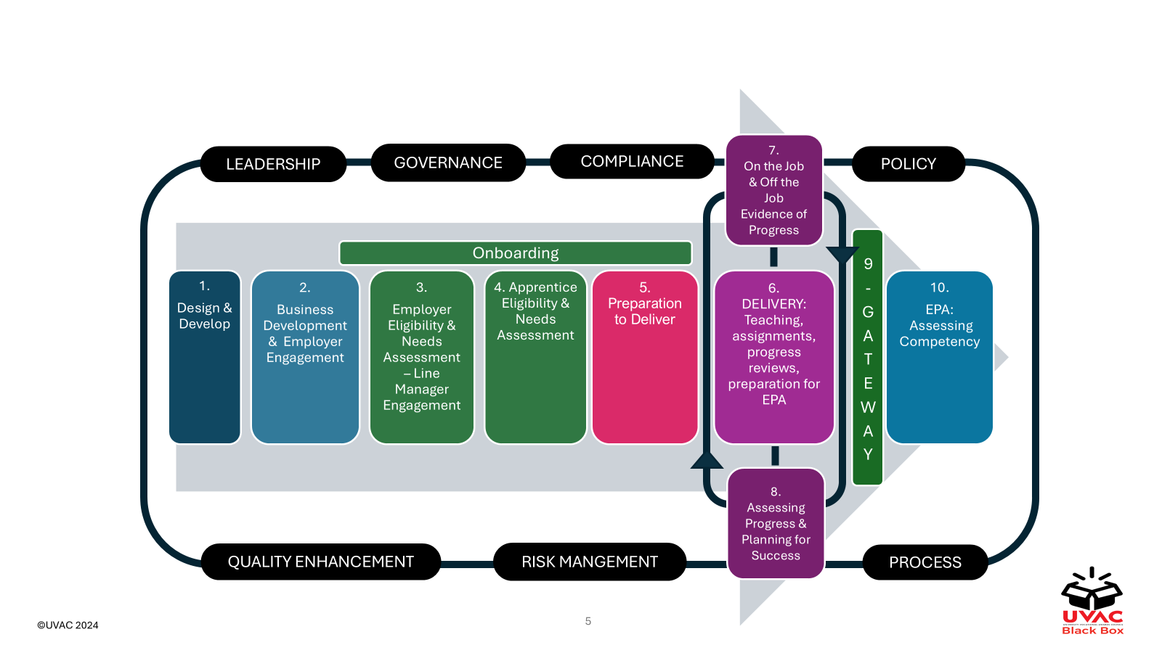
Black Box Apprenticeship Journey – Live & Coming Soon
Click on any element to access the resources available
Coming in June

Slide 27
3. UVAC Black Box
RESOURCES – TOOLS, TEMPLATES, PODCASTS & TOOLKITS
Bite
<15 minutes
Just what you need to know
Foundation
<30 minutes
Core information
Insight
30 minutes
Detailed good practice
Practical case studies & podcasts
Immersion
Live online webinar
Interactive Q and A
2 hours
Webcasts & Webinars
Develop your playlist
Range of detail
Range of times
Register for a UVAC account :
admin@uvac.ac.uk
www.uvac.ac.uk

Slide 28
Black Box Resources Table
* All of the existing resources will be updated to align with the funding rules as soon as possible before July 31st

Slide 29
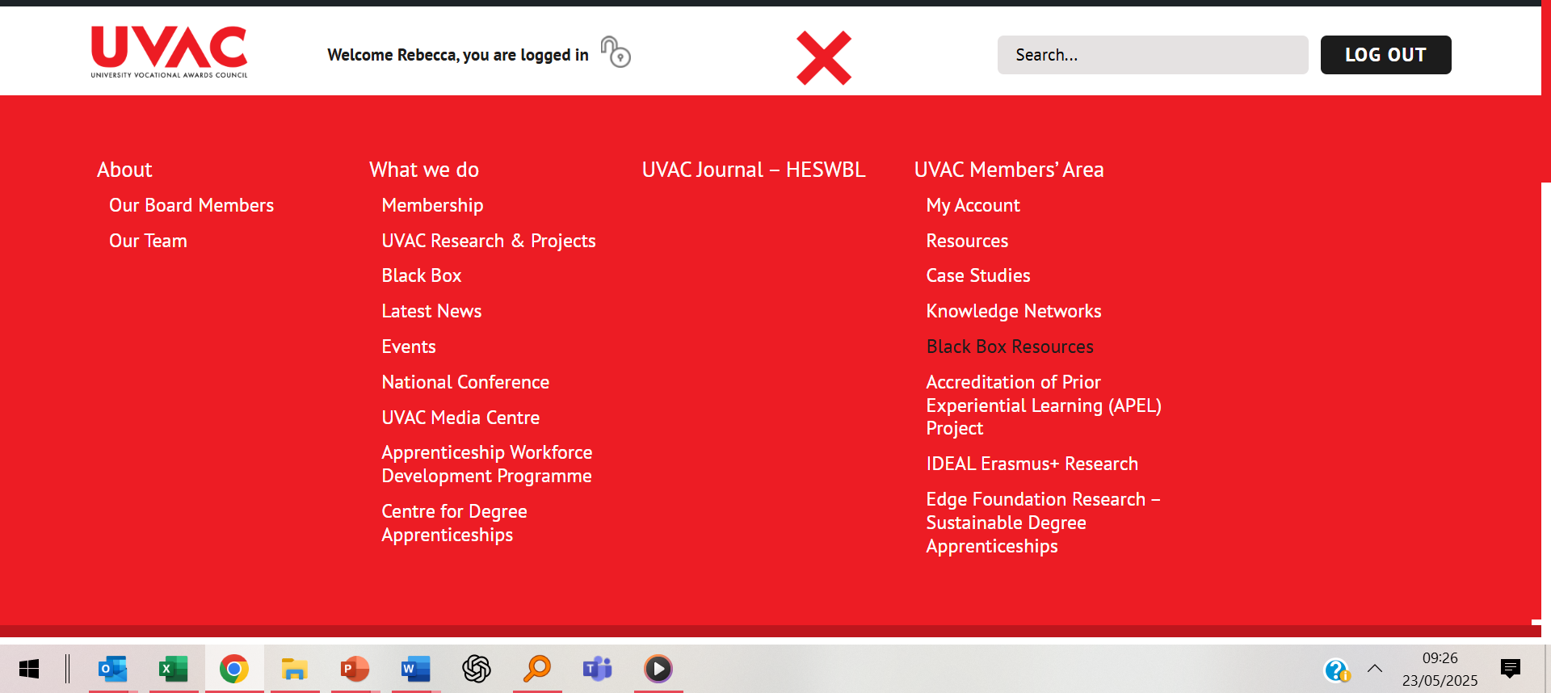
Accessing the Black Box Resources – Log in to the Members Area

Slide 30
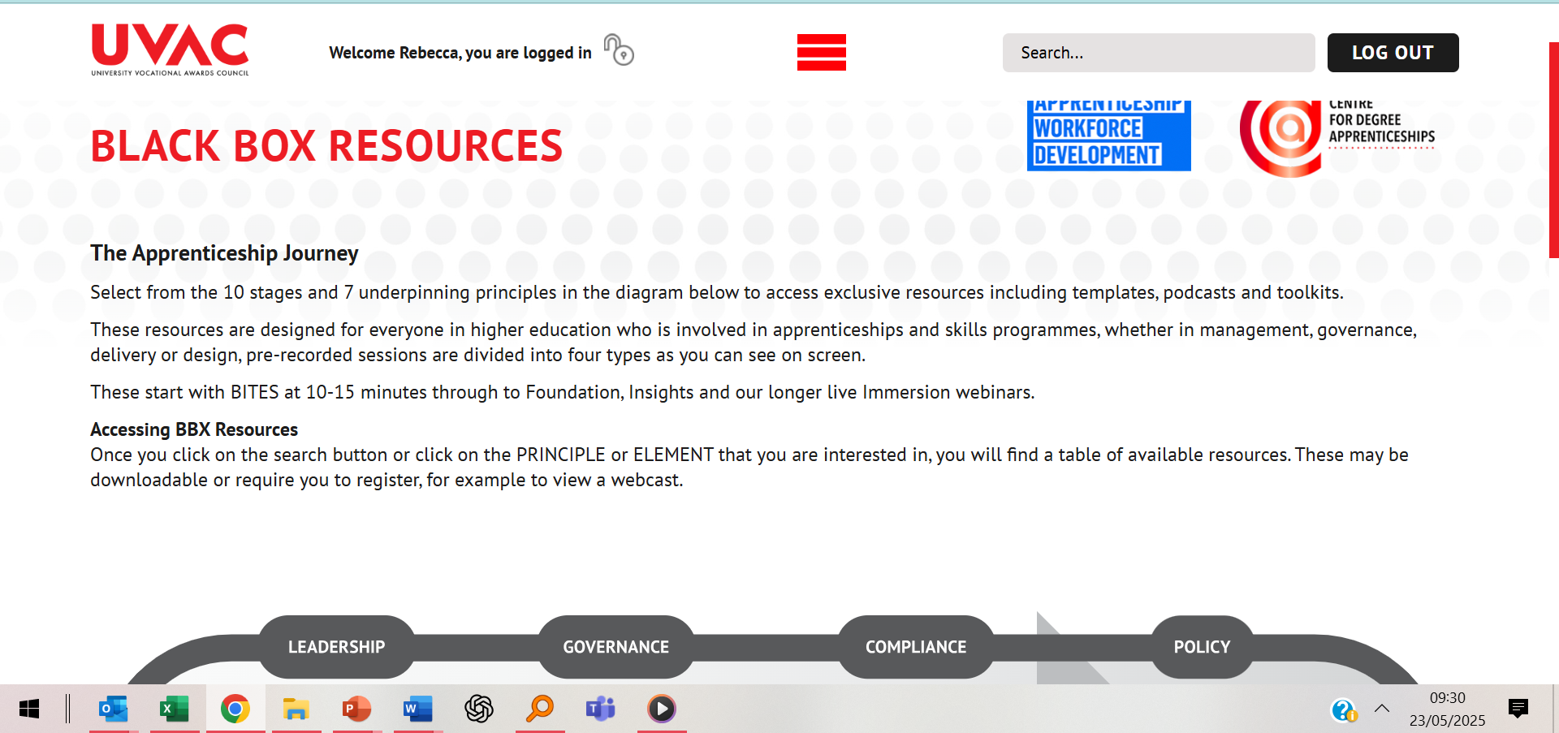

Slide 31
Black Box Journey – Live & Coming Soon
If you would like us to develop a webcast or resource on a specific topic – let us know - email me r.rhodes@ bolton.ac.uk
Click on any element to access the resources available
If you have a story to tell or a resource to share and would like to feature in one our INSIGHT Talking Heads case studies email me r.rhodes@ bolton.ac.uk

Slide 32
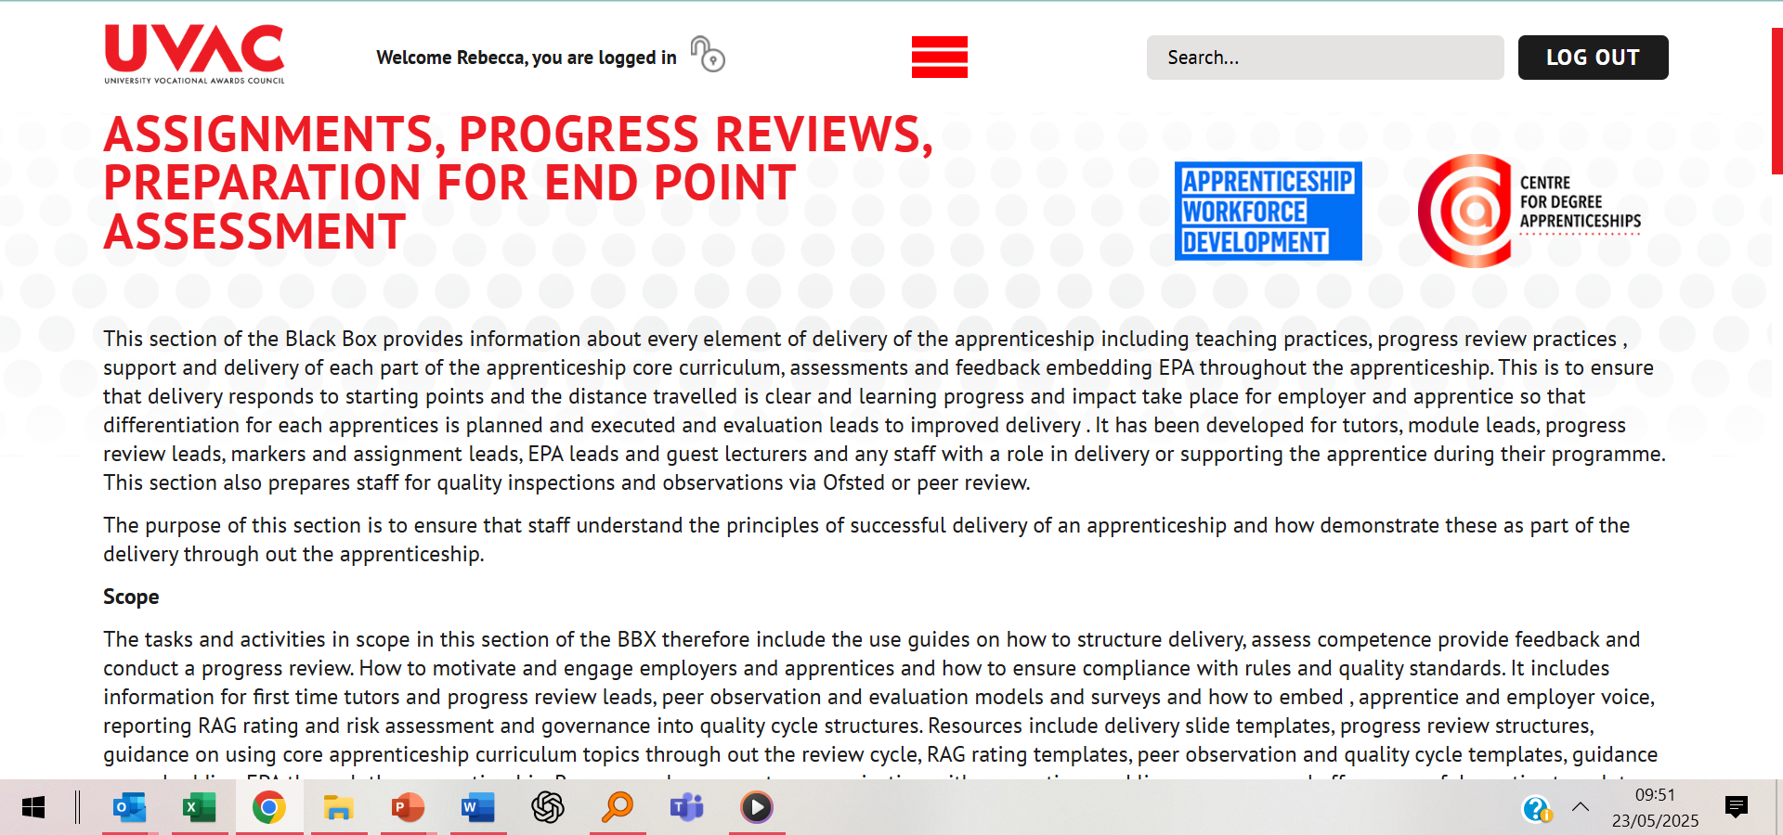
Element 6 - Overview

Slide 33
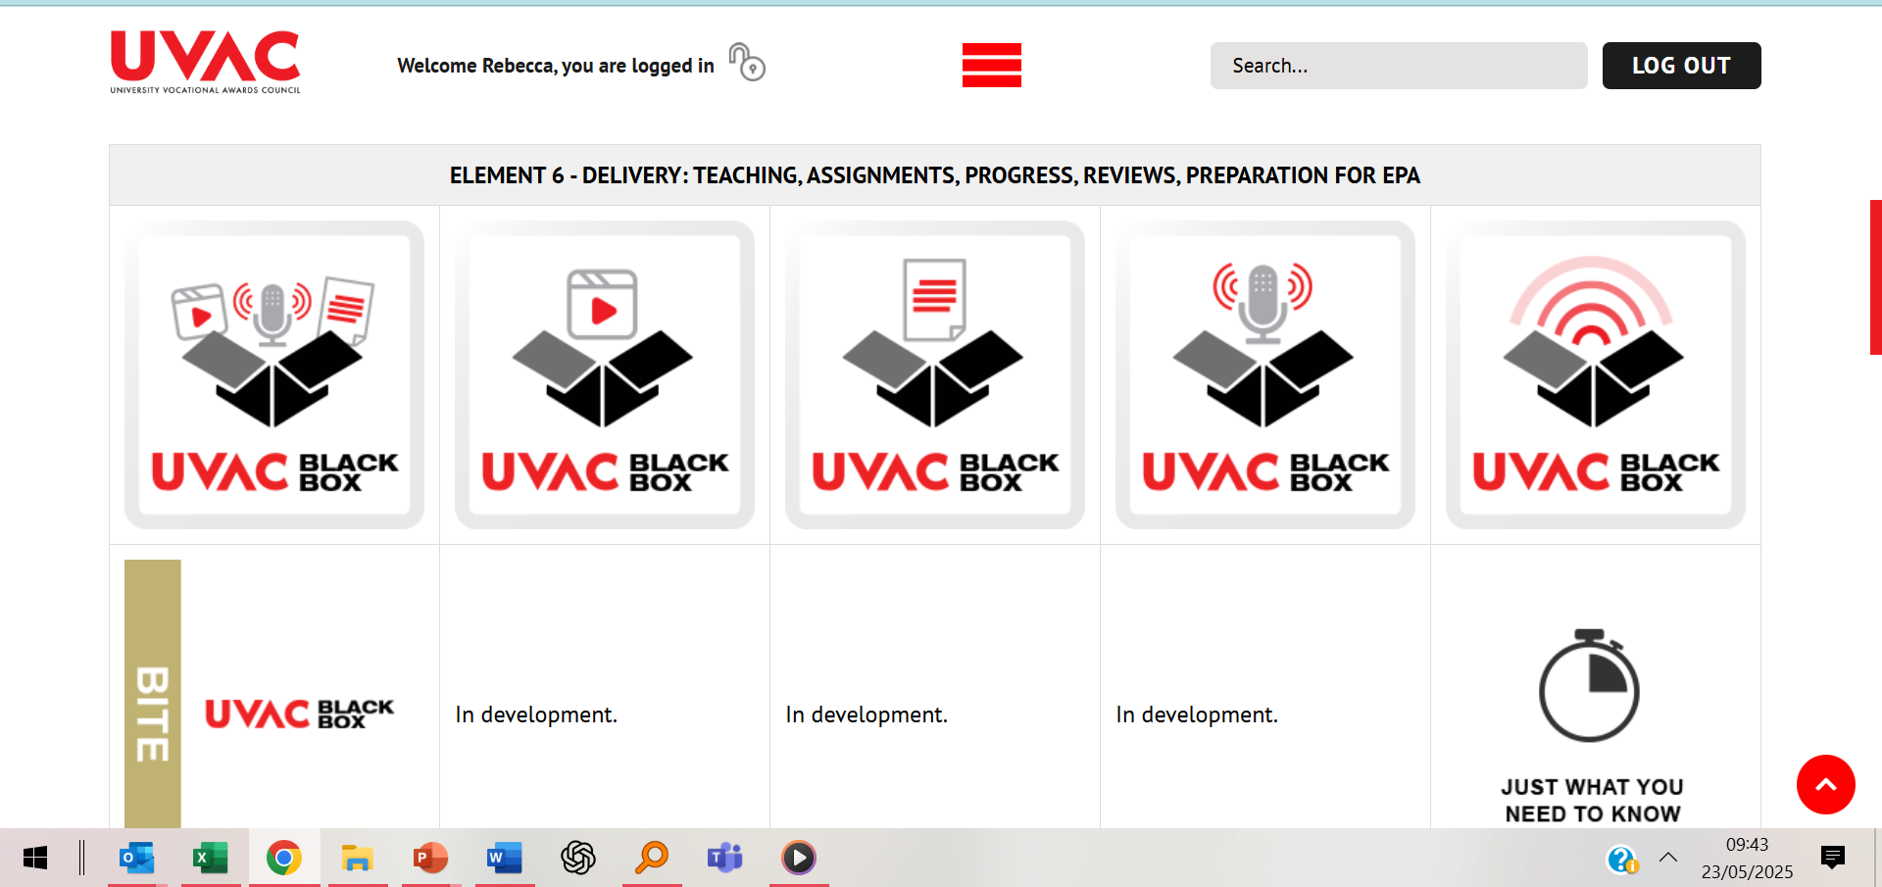
Black Box Resource Types

Slide 34
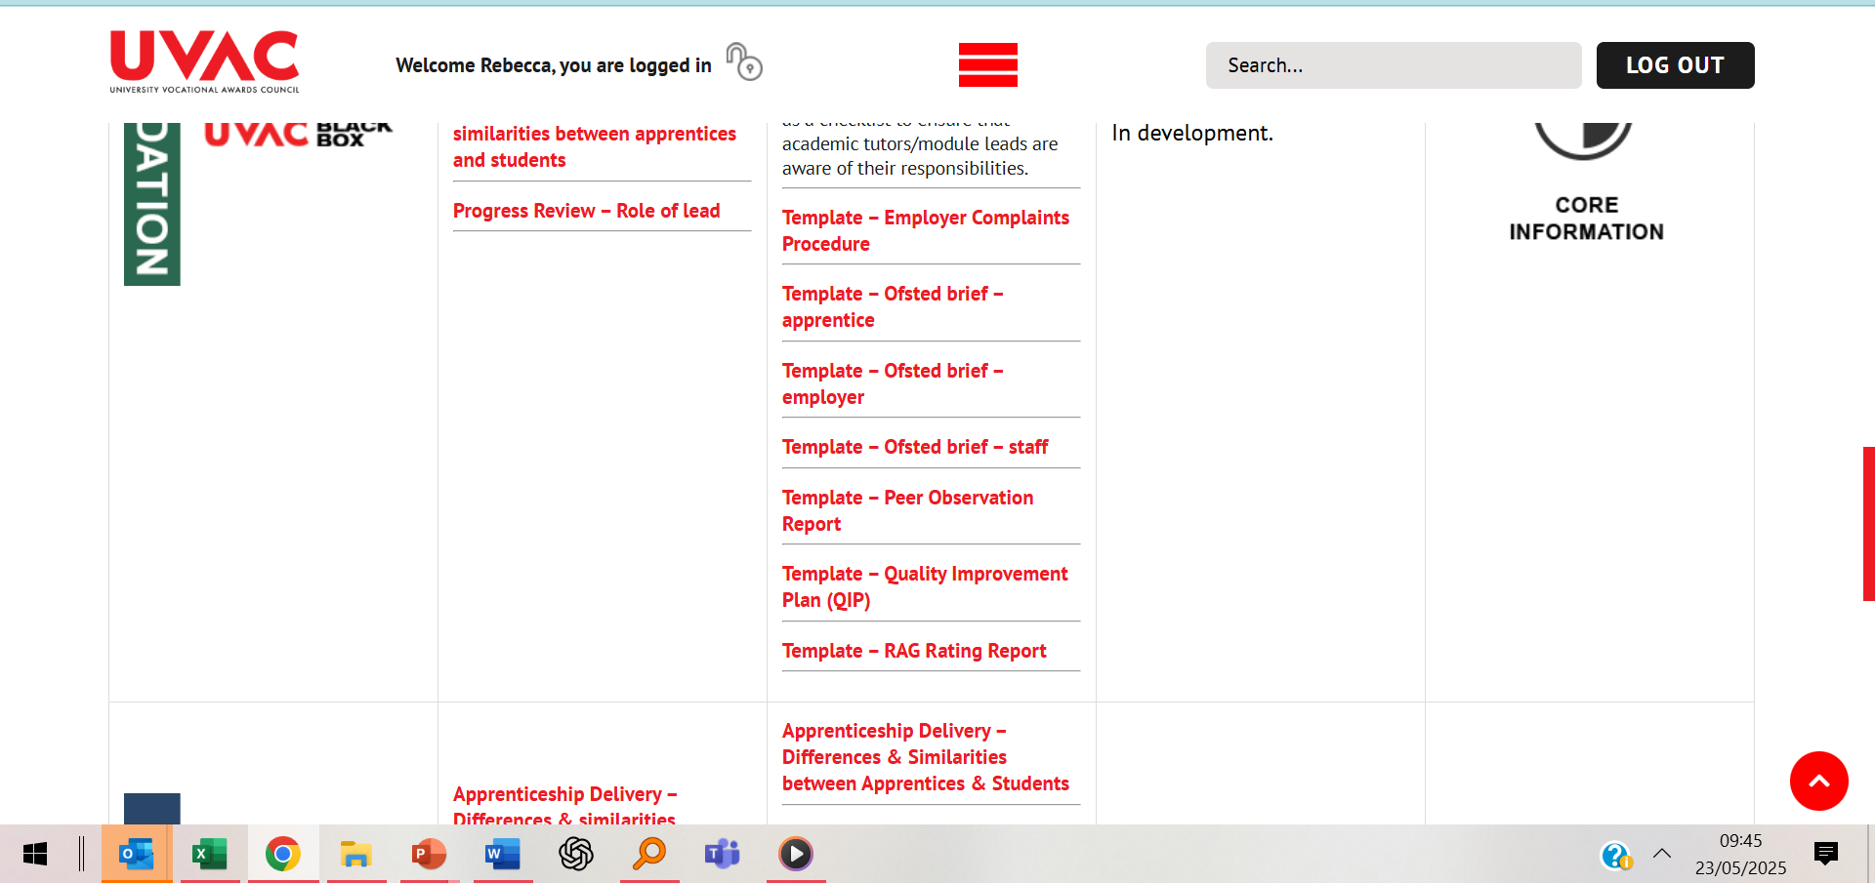
6. Delivery Webcasts & Resources

Slide 35
QUESTIONS ?

Slide 36
3. UVAC Knowledge Networks: Dr Nicky Westwood

Slide 37
UVAC Knowledge Networks
Delivery of 11 UVAC networks across different subject and standard areas.
What do our networks do?
Building national Knowledge Networks that connect members across diverse institutions.
Regular meetings and events focused on sector best practice, collaboration, and sharing resources.
Encouraged participation from a range of professional backgrounds—senior leaders, course managers, lecturers, quality managers, and more.
“Over the past year, our UVAC Knowledge Networks have brought together leaders and practitioners from across the sector. We’ve created spaces for learning, peer exchange, and collaborative problem-solving, with hundreds engaging through our national and subject-specific meetings.”

Slide 38
What has worked well
“Our networks are highly valued for enabling collaboration, supporting the sharing of best practice, and providing a friendly, inclusive space for tackling sector challenges together. Members consistently highlight the benefits of national networking, quality speakers, and peer learning.”
High Satisfaction: The vast majority of respondents are satisfied or very satisfied with the networks, with over two-thirds saying they would recommend them to colleagues.
Collaboration & Networking: Members value the opportunity to learn from sector peers, share best practices, and collaborate on real sector challenges.
Supportive Community: The networks foster an inclusive, open, and supportive environment, reducing isolation and strengthening professional ties.
Quality Inputs: High-quality external speakers, up-to-date policy briefings, and national networking—especially smaller, focused breakout groups—are all seen as strengths.

Slide 39
What’s Working Well – Member Feedback
Opportunities to learn from sector wisdom—approaches/perspectives of others.
Collaboration to address issues, create resources and forge change – fills a community of practice gap.
Opportunities to network nationally with colleagues from a range of institutions, including smaller groups in breakout rooms.
Inclusive, safe, friendly and collaborative community (can be quite isolated in role).
Quality of external speakers.
Policy updates.
Others valued ‘open discussions on key current topics’ and the ‘quality of external speakers.’ It’s clear these networks fill a real gap for peer learning and community.

Slide 40
Where next?
Broaden Content: Members want more diverse topics, broader coverage (including regulation and data), and more varied speakers (including students, employers and non-provider perspectives).
Increase Engagement: Calls for more blended (online + face-to-face) delivery, and easier access to resources and sign-up processes.
Policy Voice: Continue and strengthen our collective advocacy for policy changes, with members seeing the network as a vital voice to government and policy makers via UVAC representation.
Fill Gaps: There is appetite for new networks—especially around accounting finance, research, management, digital and AI, data quality, and student voice.
Maximize Participation: Tackle barriers like timing and workload and clarify network membership and opportunities for involvement.
Looking ahead, members want us to broaden our topics, diversify who’s involved, and make it even easier to access meetings and resources. There’s a real desire for our networks to be a louder policy voice and to create new spaces—especially around research, digital skills, and student and employer voice.
This Photo by Unknown Author is licensed under CC BY

Slide 41
Our Knowledge Networks have brought together sector leaders and practitioners in an inclusive, collaborative space. We’ve seen high satisfaction—members value the opportunities to learn, network, and work on real challenges together. Looking forward, we want to broaden our content, bring in new voices, and make participation even easier, all while continuing to influence policy and fill gaps with new networks.
Thank you for your engagement—let’s keep building this community together.

Slide 42
4. Final word
UVAC National Conference
Call for break-out leads
Membership Renewal starts June for AY 2025/26 INCLUDES ONE CONFERENCE PLACE
Invitation to hear from Skills England’s CEX Tessa Griffiths on Friday, 20 June at 12 noon. Register HERE
Find SoTN recordings and slides HERE
Next SoTN Friday, 11 July 12 noon. Register HERE
BOOKINGS ARE NOW LIVE. CONFERENCE REGISTRATION HERE.
HERA Guidance on use can be accessed HERE.

Slide 43
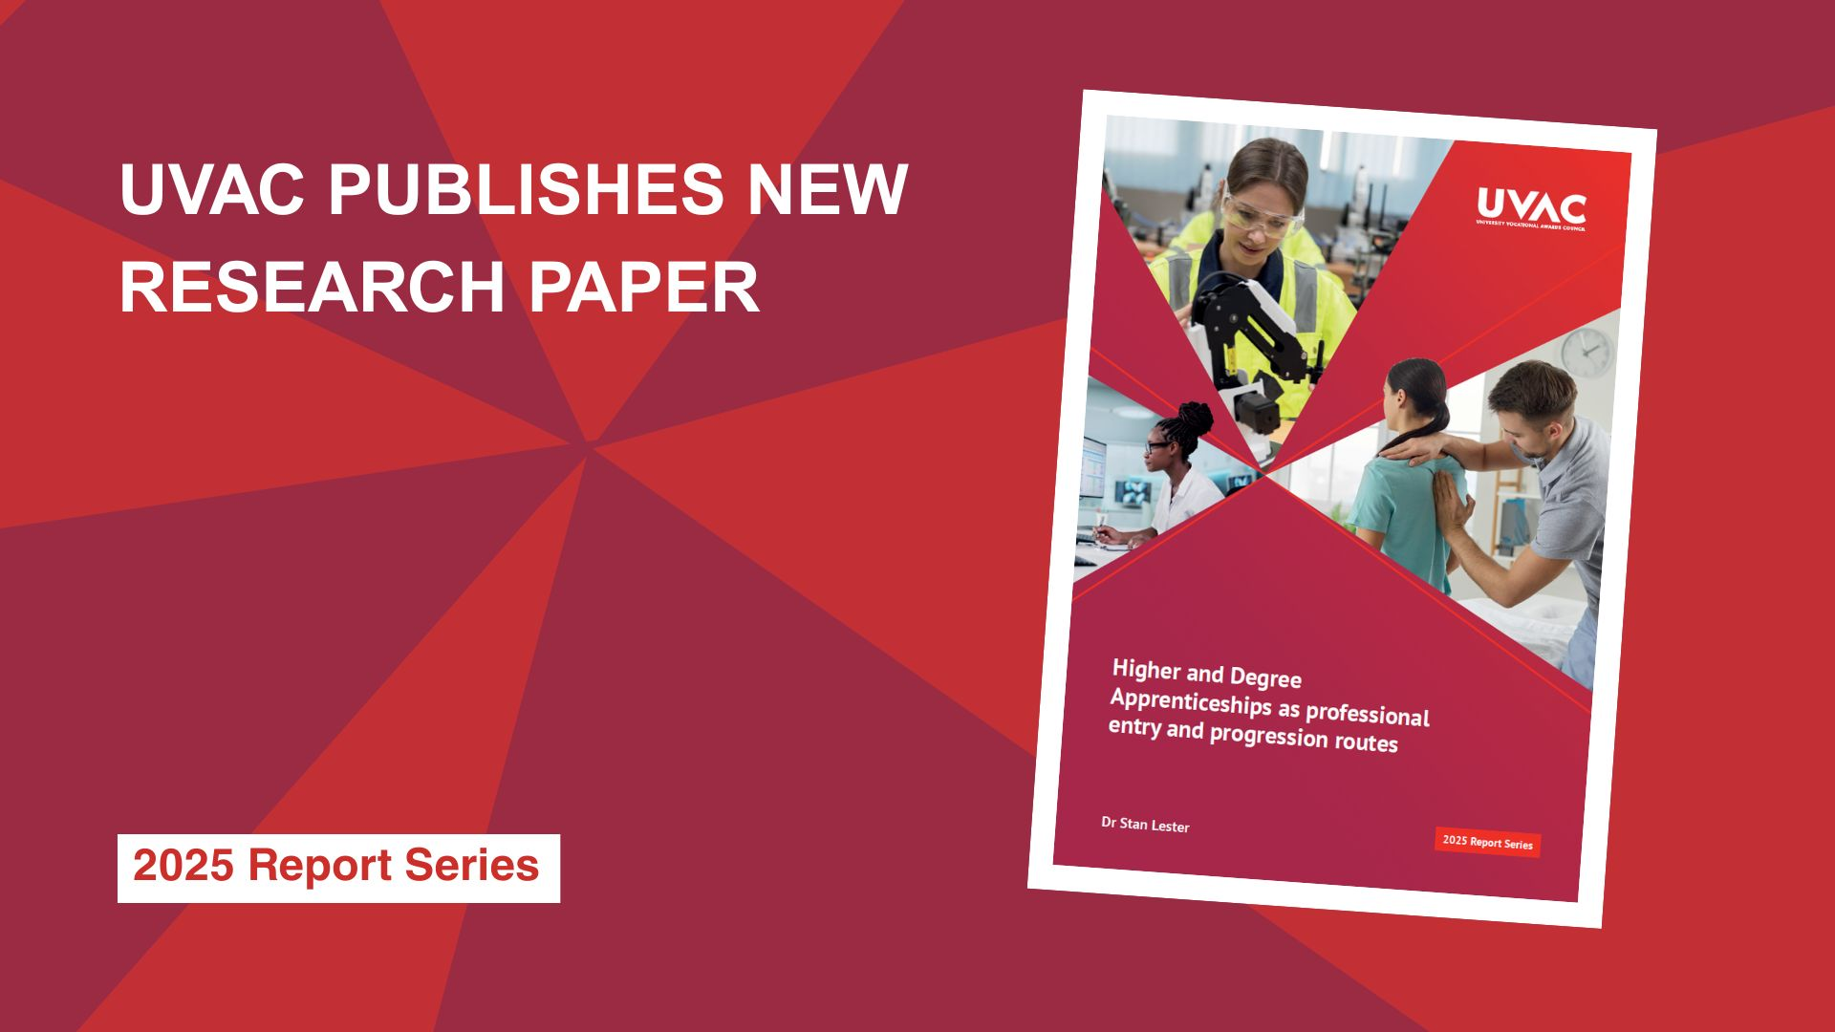
4. Publications: Reports, Briefings, Research
UVAC Strategic Priorities 2024-2027
Assessment Challenges in Integrated Professional Development
Navigating the Growth and Skills Levy and Skills England
Beyond Apprenticeships: decoding and progressing technical education opportunities in England
Higher and Degree Apprenticeships as Professional Entry and Progression Routes
All Degrees are Equal. But Some are More Equal than Others

Slide 44
Thank you

