Slide 1



Self assessment – positioning your provision.
October 2023
Kerry Boffey

Slide 2
Ofsted’s expectations
It is not mandatory to produce a self-assessment report.
There is no set format Ofsted expect or require.
However……
Inspectors will ask you ‘how’ you evaluate your provision, who contributes, is it an accurate reflection and how does the process inform and drive improvement planning?

Slide 3
Self-evaluation – the first step in self assessment
The opportunity to review how effectively you manage, coordinate and deliver your training programmes and consider what the impact of your work is upon the learners’ experience and achievements.
Involves gathering a range of evidence to allow you to form judgments about what you do and identify what is working well (strengths) and highlight where aspects could be better (areas for improvement).
Provides direction for the quality improvement plan.

Slide 4

If we are going to do it…..
Let’s do it well!

Slide 5

A daunting task
Focus on the end goal.
At the end of the process your organisation and/or nominee needs to have a clear and good understanding on their provision in line with the EIF and impact on learners.
Produce a succinct, well written self-assessment report accompanied by a robust QIP.

Slide 6
Self evaluation and improvement planning - considerations
When is it undertaken and how frequent?
What contributes to the process?
Who is involved in the process?
What are the key messages we are trying to convey in our SAR?
How will we utilise the information and create an effective improvement plan?
Who is responsible in the organisation for the self assessment report?

Slide 7

The process
Collect evidence and evaluate provision
Carryout detailed data analysis to form judgments in line with the EIF
Formulate a self-assessment report
Share with stakeholders for feedback
Re-evaluate and edit
Finalise and share
Upload to the Ofsted portal
Prepare an executive summary or position statement
Notes:
Quick TIP
As a FIN member you can send on your SAR for external and impartial feedback.

Slide 8
FIN resources relating to self-evaluation and improvement planning
6.416 - Writing better SAR judgments for impact
6.417 - Self-assessment template (MS Word)
6.418 - Self assessment template for curriculum teams (Ms word)
6.419 - Self-assessment position statement
6.420 - A Self-assessment analysis tool
6.421 - Self-assessment quality indicator
6.425 - QIP template guidance notes
6.426 – QIP template (MS Word)

Slide 9

Let’s take a closer look
Consider:
Strengths
What do you do well?
What is good about it?
How do you know?
Areas for further development
What can you improve?
What is the problem?
What do you need to do to overcome the problem?

Slide 10
Education Inspection Framework
Quality of education
Safeguarding
Behaviour and attitudes
Overall effectiveness
Personal development
Leadership and management

Slide 11
Quality of education
Quality of education
Intent
Curriculum design, coverage and appropriateness
Implementation
Curriculum delivery
Teaching (pedagogy)
Assessment (formative and summative)
Impact
Attainment (qualifications and assessments)
Progress
Knowledge and skill development
Destinations
Notes:
11

Slide 12
Planned and sequenced towards cumulatively sufficient knowledge and skills for future learning and employment
Ambitious curriculum, adapted for less or differently abled
Full range of subjects for as long as possible, ‘specialising’ only when necessary
Intent

Slide 13
Implementation
Trainers technical subject knowledge
Highly effective and motivational learning environments
Delivery models, styles, pedagogy and individual focus
Checking understanding and feedback
Effective assessment

Slide 14
Impact
Development of knowledge and skills.
Achievements
Preparation for the next stage, career advancement, further learning & work
What else?
Bespoke to YOUR organisation.
Notes:
14

Slide 15
Behaviour and attitudes
Behaviour and attitudes
Behaviour
Employability
Attendance & punctuality
Respect
Attitudes to learning
Notes:
When talking about apprentices – shouldn’t we be looking at behaviour(s)
15

Slide 16
Leadership traits
Time management
Prioritising decisions taken
Attention to detail
Leading by example
Meetings management
Empathy
Duty of care
Ability to motivate others
Decision making
Projecting credibility and professionalism
Use of language
Humility
Financial awareness
Ethical approaches
Risk assessment awareness

Slide 17
Personal development
Personal development
Enrichment
Fundamental British values
Careers guidance
Healthy living
Citizenship
Equality and diversity
Preparation for next stage
Notes:
What is reasonable with apprentices – adult particularly ? EG – Healthy living – bottle of wine ?
17

Slide 18
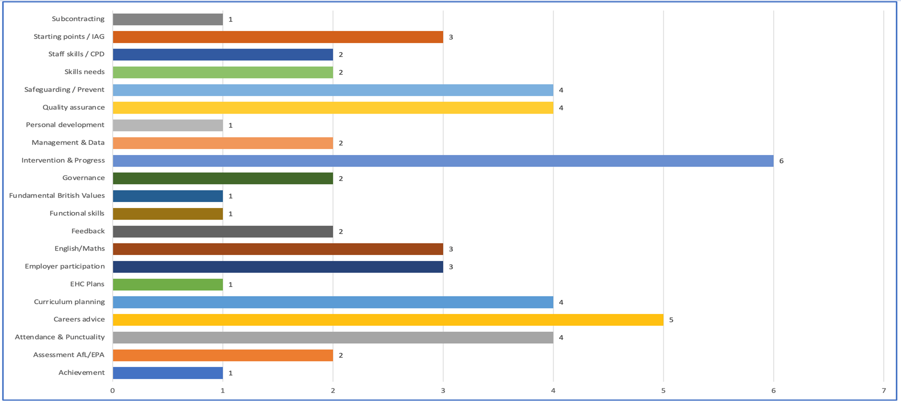
FIN HE inspection analysis
Careers advice

Slide 19
Leadership and management
Leadership and management
Vision, ethos
Operational management
Staff development
Staff workload and wellbeing
Learner experience
Governance/oversight
Safeguarding
Compliance
Provision for SEND/ALS
Notes:
.
19

Slide 20
Leadership and management
Are leaders and managers (at all levels including governors) influential in ensuring the organisation delivers high quality provision?
Are staff and the coordination and organisation of facilities and operations well managed?
Are all stages of the learner journey well managed including the management of additional learning support?
Is performance data well managed and used to improve the quality of the work undertaken?
Is self-assessment and improvement planning influential in making the quality of provision stronger and more effectively meeting the needs of learners?
Are subcontractors well managed and are there good working links with other partner organisations including employers?
Is good use made of feedback from learners, employers and other stakeholders to improve the quality of provision?
Are safeguarding (including health and safety) and equality and diversity well promoted?

Slide 21

The challenge
Evidence and feedback collected from each area
Do the judgments stand up to scrutiny?
Can you evidence through data?

Slide 22
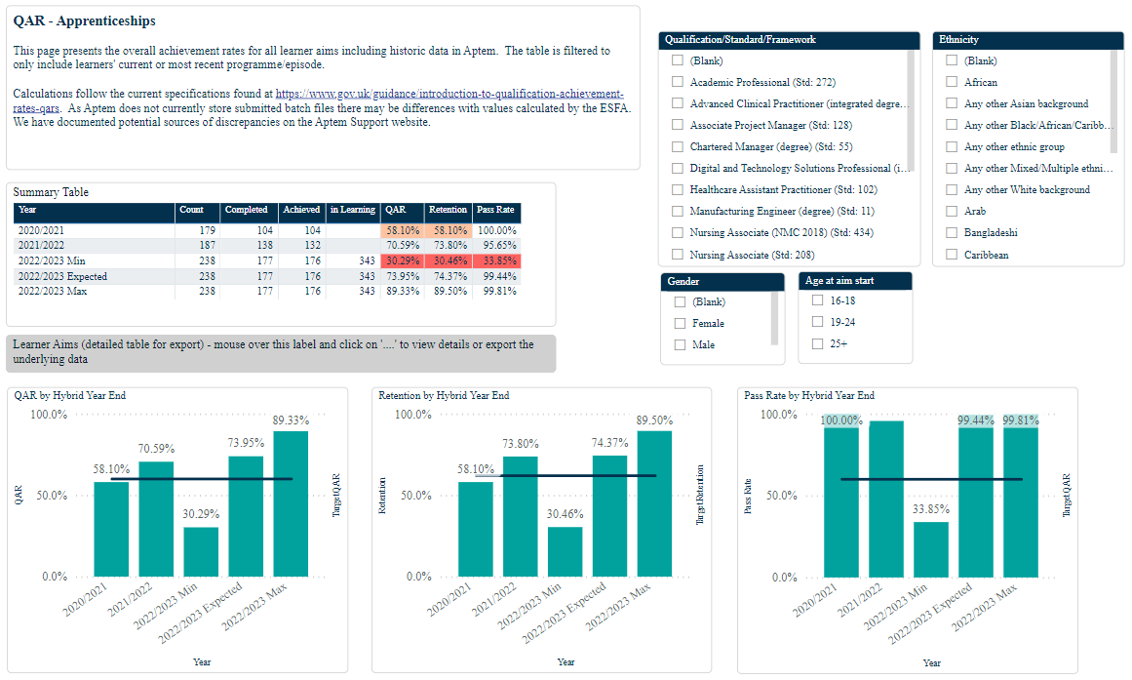
Data analysis

Slide 23
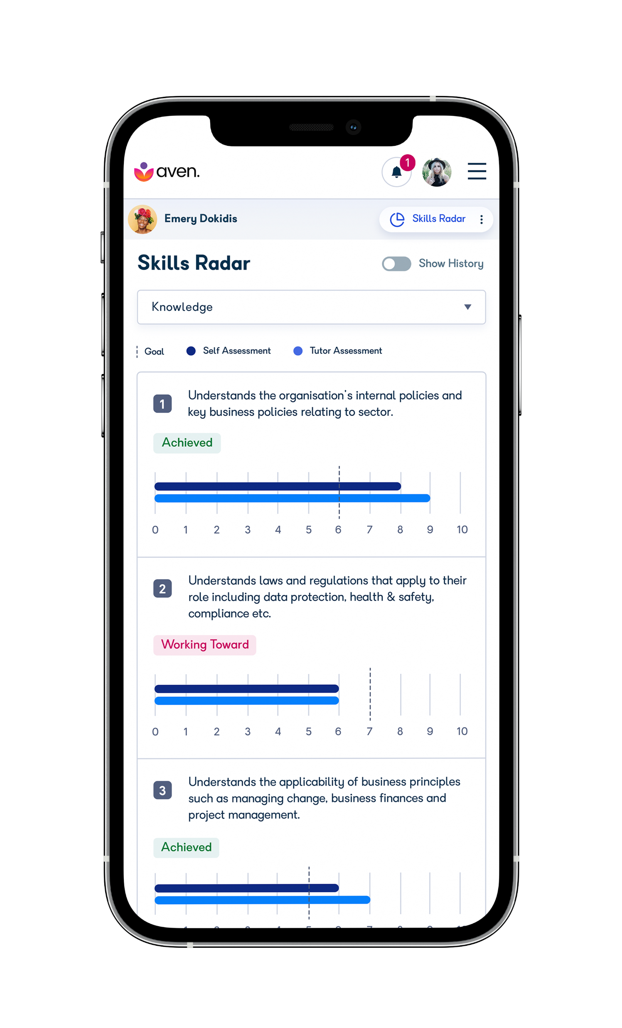
Does the data stack up?
Where good, or better practice is identified are you able to evidence through data analysis?

Slide 24
Remember
It makes sense to compile the report at the conclusion of each contract year when the end of year performance data can be reviewed that measures the impact of the work undertaken.
All the information must be scrutinised and evidence checked before putting into the self-assessment report
Information and evidence can be gathered at anytime and is often linked to an organisations quality calendar (a plan and timetable of quality assurance activities that are undertaken throughout the year such as observations of training, feedback from stakeholders, data review etc.).

Slide 25

FIN tips – positioning your provision.
Imagine the Self assessment report as a shop window.
Notes:
Would you put all you stock in the window?

Slide 26
If you are aiming for Outstanding be creative in your judgement words, such as… innovative, excellent, exceptional.
Create a 2-page Executive summary or position statement
Don’t contradict
Don’t include areas for improvement without a solution.
Everything needs to impact on learners!

Slide 27
We know that self assessment and improvement planning should:
Be linked to learner progress, outcomes and achievements
Include a wide range of evidence
Form clear judgements about what is working well and what could be better
Project an accurate insight into the work we perform and the achievements by learners
Involve contributions from all stakeholders
Have clear, measurable plans and actions for further development that drive improvements
Reflect our considerable knowledge of our provision

Slide 28
Revisit - Our purpose
What is the purpose of our learning and skills programme and what is it intending to offer learners?
Notes:
28

Slide 29
Evidencing improvements/progress
Starting point Development Activity Today Future plans

Slide 30
Be judgemental
Grade each section on the four-point Ofsted scale
Use judgmental words that are associated with Ofsted grading
Refer to supporting evidence and make the report text reflect the grade you proposing
Always refer the judgement and text to the impact upon learners
Don’t contradict yourself e.g. ‘good support for learners’ - ‘poor use of initial assessment’
Remember the linkage – achievements – teaching - management

Slide 31
Making the improvement plan effective
Consider the issue(s)
What are the improvement actions?
Who is responsible?
When will the issue hopefully be addressed?
How and when will progress with the issue be monitored?
At what stage can the issue be closed off as being completed?

Slide 32
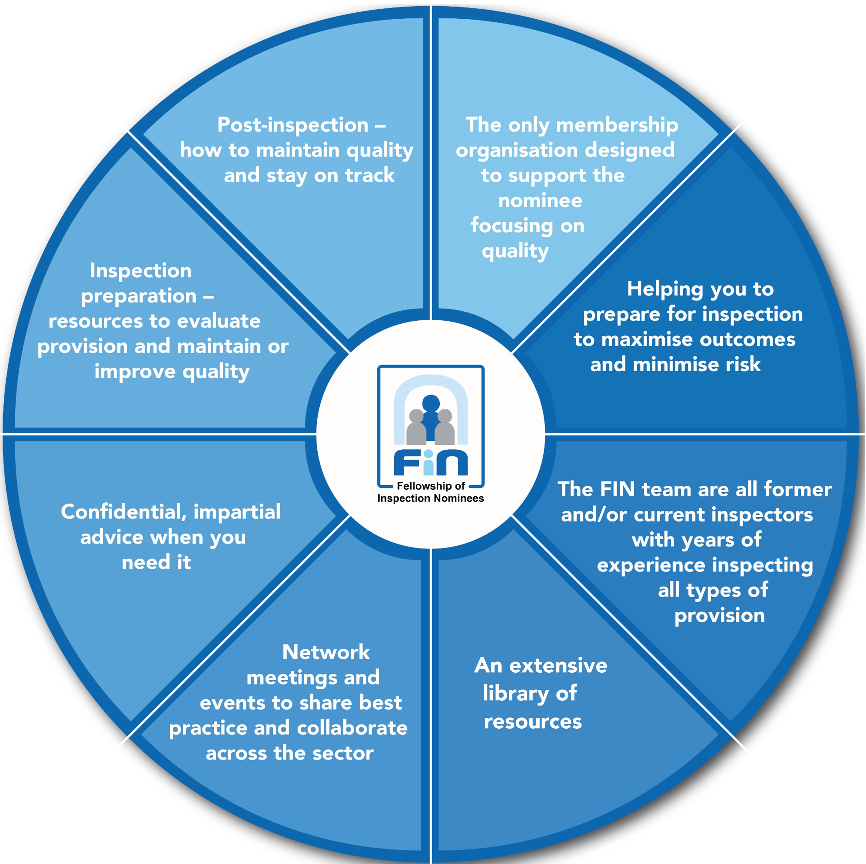
Benefits of FIN Membership
The advice and support we receive from FIN is exceptional. Highly professional and leading experts in their field, the resources, webinars and masterclasses, provide clear, concise guidance on all aspects of quality improvements and inspection. We know we can rely on receiving up to the minute, detailed analysis and guidance on any changes of inspections. FIN has definitely played a key role in our drive to enhance quality of provision for out learners and clients.
David Millar,
Director of Excellence & Learner Experience
Corndel

Slide 33
FIN resources relating to self-evaluation and improvement planning
6.416 - Writing better SAR judgments for impact
6.417 - Self-assessment template (MS Word)
6.418 - Self assessment template for curriculum teams (Ms word)
6.419 - Self-assessment position statement
6.420 - A Self-assessment analysis tool
6.421 - Self-assessment quality indicator
6.425 - QIP template guidance notes
6.426 – QIP template (MS Word)

Slide 34

FIN Events
Aiming for Outstanding 02/11/2023
Embedding maths into the curriculum 07/11/2023
Safeguarding Working Group 07/12/2023
Higher Apprenticeship Providers Networking Group 16/01/2023

Slide 35
Thank you for attending info@fin-online.org.uk

