Slide 1
The Register of Apprenticeship Training Organisations 2018 Making an Effective Application INTRODUCTION-updated 10 Jan 2018
Rebecca Rhodes, Senior Associate, UVAC: r.rhodes@bolton.ac.uk

Slide 2
Content
Difference
Timeline
Common Pitfalls
Narrative Questions

Slide 3
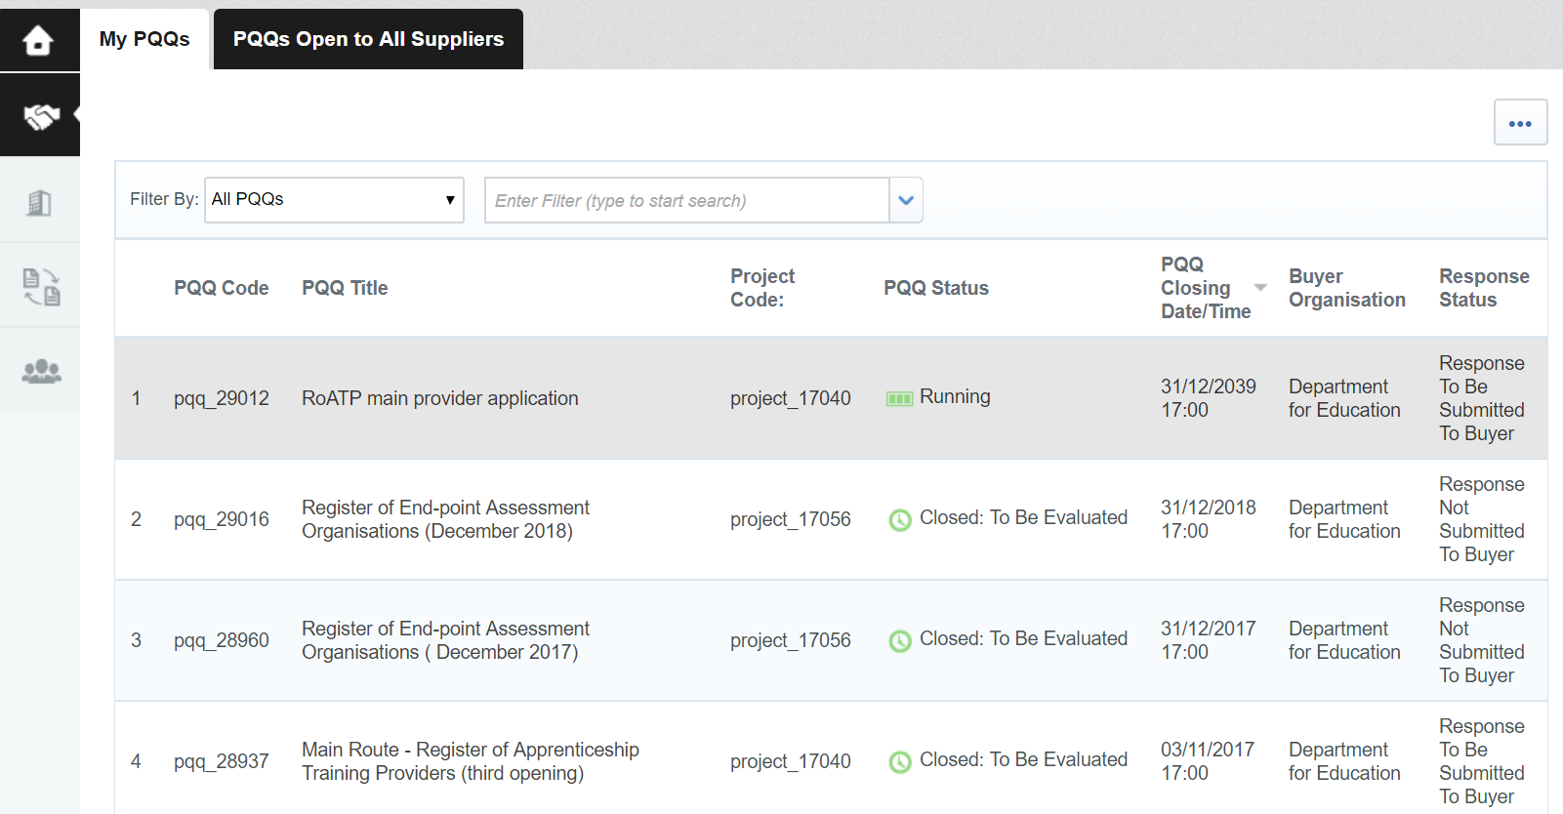
PQQ 29012

Slide 4
Current Issues
Large and complex application
Guidance and Form not always in sync
Exemptions from ‘People’ indicated but no criteria
Guidance missing from some narrative questions
Work carefully through PR1-4: this should result in completing one section from 1.13, 1.14 or 1.15
10 text / narrative sections
READ the guidance as you complete each question and point

Slide 5
Timetable
Application Close
Application Assessment
From First WORKNG DAY of the Month
Application Outcome
12 weeks
last WORKING Day of the month
12 weeks
With Feedback
Reapply
Capped at TWICE a year

Slide 6
The Difference in Summary
Proof of trading for 12 months
Financially stable (evidenced by financial information),
Funded by OfS means exempt from Financial Health
Skilled and are able to deliver quality apprenticeship training in the chosen sector /apprenticeship , before you apply
Outstanding or good grade from Ofsted less than years ago or funded by OfS are exempt from certain questions on the leadership and management sections
All providers must be listed on the RoATP - £100k threshold for subcontractors (including employers) removed
Supporting providers limited to £100k in year 1, before rising to £500k per year
Main and employer providers cannot act only as subcontractors

Slide 7
The Difference in Practice
Size and Scope
At least 10 narrative questions ….. I think.
Readiness
Evidence of ready to deliver
Individual Staff
Management
Delivery
Proof
Policy Documents READ THE GUIDANCE ON EACH
Templates
Employee Experience
Management Hierarchy
Appeals Process

Slide 8
Evaluation
Three criteria
Financial health - Due diligence - Readiness and quality
Readiness and quality outcome
We will assess your readiness and suitability to train apprentices using information provided in your application for capacity, capability, apprentice welfare and engagement. We need to be satisfied that you do not pose a risk to apprentices through poor quality provision and welfare.
To do this we will confirm:
your management and training staff have experience of training learners and are established within the sectors you deliver. Only through experience can a provider understand the requirements of different employers and learners
you have set high expectations of quality of training and have a process for both maintaining and improving this.
you have planned for the first 12 months of being on the register taking into account the ability that currently exists in your organisation to meet this
you have policies and plans in place that meet the needs of apprenticeships and the welfare of apprentices. You must provide these where requested and ensure they meet the requirements shown in section 6
you are ready to engage with employers or apprentices. You must have processes in place for the assessment of prior learning and delivery of English and maths, a clear understanding of how you will deliver the 20% OTJ training ensuring it meets requirements of the funding rules, as well as templates to contract with employers and learners. These must meet the requirements defined in section 6

Slide 9
Structure

Slide 10
Document – Exemptions
‘We will get confirmation from other registration processes, or information held in the public domain’
If you are funded by OfS
You do not need to complete:
‘your apprentices’ welfare’
Financial Health (1.6.2 HEI monitored & supported by OfS)
If you have an Ofsted grade of ‘outstanding’ or ‘good’ for apprenticeships, awarded in the last 3 years and have maintained ESFA, Skills Funding Agency (SFA) or Education Funding Agency (EFA) funding since then:
You do not need to complete:
‘your leaders and managers’
‘your apprentices’ welfare’

Slide 11
Narrative Section Guide
UVAC word form including bullets from the main guidance for each narrative section – available from the website today

Slide 12
At A Glance
Your organisation (OD-)
Your declarations (DE-EX-)
Your financial health (FH-)
Your profile (PR-)
Your leaders and managers (CC-LM-)
Upload Management & Hierarchy TEMPLATE
Your people and planning (CC-PP-)
Upload employees relevant recent experience and qualifications TEMPLATE
Your readiness to engage (EN-)
Your apprentices welfare (GO-)
Your primary contacts (PC-)
Your application declaration (DE-AP-)

Slide 13
You will Need to Provide – CHECKLST
Documents
Policies
management hierarchy for apprenticeships
ICO registration certificate
Employer contract for services template
Commitment statement template
professional development for employees
Employer engagement
policy, procedure and process for complaints
And others if not exempt
There are requirements for what must be shown for each policy and process - check the guidance
Beware ‘student’ only in your documents – check relevance
UVAC Templates will be ready shortly
Process
evaluating quality of training and outcomes
sample of your employees’ relevant experience and expertise
Employer engagement
initial assessment of prior learning
delivering English and maths

Slide 14
What Each Section Requires
3.1 Your organisation
All organisations across the 3 application routes must provide a:
management hierarchy for apprenticeships
ICO registration certificate
3.2 Your financial health
Depending on your answers in the application,
financial statements
management accounts
accounts for parent company
financial forecasts if you are applying as a supporting provider
3.3 Your leaders and managers – if not exempt
a process for evaluating quality of training and outcomes.
3.4 Your people and planning – if not exempt
sample of your employees’ relevant experience and expertise
policy for professional development for employees
3.5 Your readiness to engage
policy or practice for how you will engage with employers
policy, procedure and process for complaints
template contract for services for use with employers for the delivery of apprenticeship training
We will ask organisations applying to the main and employer provider route to provide a:
Commitment statement template
process for performing initial assessment of prior learning
process for delivering English and maths

Slide 15
What Each Section Requires
– if not exempt
3.6 Your apprentices’ welfare
We will ask all organisations to provide a:
policy for continuity of apprenticeship delivery
policy for equality and diversity
policy for safeguarding
policy that complies with Prevent
policy for health and safety

Slide 16
Relevant recent experience and qualifications -Template
At least 1 and up to 10 employees
capabilities to train apprentices within your delivery sector(s).
For each employee you must provide their:
full name
job role
length of time with organisation
sector(s) in which they will provide training
length of time in sector(s) in training and apprenticeships
experience in sector(s) where gained and job role at the time
sector relevant qualifications
teaching and training qualifications
membership(s) of sector bodies
approvals from awarding bodies
You may be asked for evidence in support of your response.
Demonstrate Capability ….esp Sector experience :
Recent employment
Joint research projects
Work based programmes actively guiding students in significant projects embedded in their employer/ placement
Work with employer bodies / trade bodies
Conference speakers
Advisers to industry
Developing the Standard / membership of Trailblazer Groups
How many to include : Demonstrate Capacity
Volume of staff (indicated in main application) sufficient to meet numbers

Slide 17
Management hierarchy for apprenticeships Template
Provide details for your senior management team responsible for apprenticeship training. For each person you must provide their:
full name
job role
time in role, in years or months
who they report to
details for other organisations they’re involved in who are receiving funding directly from Education and Skills Funding Agency (ESFA) or as a subcontractor
Demonstrate:
Led and managed from the top of the organisation
Fully integrated into the university
Sufficiently resourced :
To make decisions
To manage and mitigate risk
To cover the size of the programme
Identify any conflict of interest and wider relevant experience
Who to include : Demonstrate capacity to
Volume of staff (indicated in main application) sufficient to meet numbers

Slide 18
Managing your Response
Download and complete the excel form first then cut and paste into the online form in BRAVO
There are 10 sections – Narrative questions
Mandatory questions have red asterisks next to them and you can click ‘validate’ to check if they are complete
Save your answers - if you close the application or your session times out these will not automatically save.
Upload attachments as pdf, excel, word or pictures – check the file opens / check the file has converted fully
No hyperlinks or documents not specifically requested
For Zipped files name these as follows :
UKPRN, question reference and a two word title e.g. 12345678 OD9 Organisation Chart
Don’t password protect them

Slide 19
Working with Text Sections

Slide 20
Working with Text Questions
SFA are seeking confirmation that you are ‘competent on paper’ and action is embedded and led from the top
A reader that does not know you should be able to see from your responses that you:
have systems, processes, policies that provide regular feedback/review
That embedded and led from the top
Demonstrate how you deliver the statement or, if you don’t have a system in place, explain clearly what you are intending to do
The bullet points include key questions for response and requests for evidence. Use the bullets as the structure for your response - to tell a narrative
Don’t just regurgitate or repeat the bullet points within the question
2000 = Characters with spaces / 350 words approximately
All text sections do apply to you
Every question stands on its own, every response is assessed on its own
Each responses is scored using only the text supplied in the response so expect to repeat yourself

Slide 21
Working with Text Questions
Expect to :
Name policy documents but reference these in the narrative
Explain the key steps, process, in HOW you deliver
State the governance process – who is accountable, when do
Make sure its clear how processes, governance, enable risk management
Make it clear that all apprentices are treated as individuals and your processes ensure this is the case - initial assessment and review processes are critical to this
Confirm that the apprenticeship standards or framework is the critical benchmark for apprenticeship provision e.g. for staff CPD; for curriculum design and fit

Slide 22
Common Pitfalls

Slide 23
Common Pitfalls – Structure
Not giving evidence of formal processes and policies – quality assurance systems, contract review, etc.
Not covering what you do, or would do, to cover the areas within the question
Not addressing all bullet points contained in the question.
The response was too brief to provide assurance
Repeating back the question (listing the bullet points)
Writing a list / series of facts or bullet points, that don’t easily seem to link to the question/bullet
Not explaining how process and activities detailed impact quality capability or capacity and performance managing a contract.
Explaining achievements but not how these were achieved

Slide 24
Common Pitfalls – Content
The response did not seem tailored to an apprenticeship – watch your policy documents
Not closing the loop – not explaining how actions improve apprenticeship quality or the apprentice’s success
Not setting out how you address (or will address) underperformance and identify or mitigate risks.
Not explaining how policies and processes enable high quality delivery
No consideration of providing information advice and guidance for example at pre-course stage or when establishing next steps
Focusing on the quality of staff CPD, but there is no clarity on how this benefits learners or users
Focusing on feedback received from learners/users rather than how feedback improves learners/users experience
No reference to how learners are motivated inspired or supported to extend knowledge skills or develop their own knowledge.

Slide 25
AND MOST OF ALL
UPLOAD EARLY
DO NOT LEAVE UPLOADING YOUR DOUCMENTS UNTIL THE LAST MINUTE

Slide 26
Checklist
Read the Guidance and write to the requirements
Check that every response size is within the limit but sufficient
Read the questions again and check that you responded to what was asked with evidence - what you do
Read every response and check that you have covered all the bullet points – treat them as a checklist for each question
Ensure that Policies respond to the bullet points in the guidance covered
Check that you have explained what you do/would do and how for anything where your evidence
Check that you have referred to relevant formal documentation, policy, procedures, governance in each response.

Slide 27
Next Steps
PQQ Timetable :
Next Application Deadline 31 January 2019
Feedback to applicants circa 29 April 2019
Raise application questions via the BRAVO portal :
If this fails RoATP.mailbox@education.gov.uk
All query responses are shared–keep checking
Raise other queries through the UVAC query line uvac@bolton.ac.uk
Resources :
Webinar slides, policy checklist and narrative section narrative sections proforma are accessible from the website
Webcast: Click HERE
Webcast on Apprenticeships and University Regulations: Click HERE
?

